Slide 1
Biology Paper 2
Model Exam Question Booklet
Biology Paper 2
Topics in the Paper:
B11 | Hormonal Coordination
B13 | Reproduction
B16 | Adaptations and Interdependence
B17 | Organising an Ecosystem
RP7 | Measuring Population Sizes
Essential Content for the 2022 Foundation Trilogy Science Exam
This booklet is split into 3 parts.
Part 1
The first part is a selection of short response questions and answers that are likely to come in your Biology exams this summer. Spend time learning the answers to these questions, for example you could produce flash cards. You should self quiz yourself on these questions regularly!
Part 2
Selection of extended response questions (4 to 6 marks) that are likely to be on your paper this year, either because they have not been assessed in the last couple of years, or because they come up most years in exams. Prepare and practice your responses to these questions.
Part 3
Required practical section. In this section you will find step by step guidance for each practical. This is followed by a page of short response questions and answers to learn for each of the practicals. There are also some extended response questions (4 to 6 marks) that are very likely to be on the exam paper this year.

Slide 2

B11: Hormonal
Coordination
Fold page here
What is the endocrine system?
How do hormones travel around the body?
How does the hormonal system compare to the nervous system?
What is the pituitary gland?
Why is the pituitary gland known as a master gland?
What is blood glucose concentration monitored and controlled by?
What happens if blood glucose is too high?
What is type 1 diabetes?
How is type 1 diabetes treated?
What is a symptom of diabetes?
Why can’t insulin be taken by mouth?
What type of substance is insulin?
What is type 2 diabetes?
How is type 2 diabetes treated?
What is a risk factor of type 2 diabetes?
It is a system composed of glands which secrete chemicals called hormones directly into the blood stream.
Blood
It is much slower and involves the blood stream rather than nerves to produce an effect.
It is a master gland which secretes several hormones into the blood.
Its releases hormones that stimulate other hormones to be released from other glands.
The pancreas.
Insulin is released that moves glucose into muscle and liver cells and converts it into glycogen for storage.
A disorder in which the pancreas fails to make enough insulin. It causes uncontrolled high blood glucose levels.
Insulin injections.
Cannot control blood sugar.
It would be broken down by proteases in the stomach.
Protein
A disorder in which the body cells no longer respond to insulin produced by the pancreas.
A carbohydrate-controlled diet and an exercise regime.
Obesity

Slide 3
B13: Reproduction
Fold page here
What is DNA?
What is DNA contained within?
What is a gene?
What is the genome?
Why is knowledge of the genome important?
What characteristics are controlled by 1 gene?
What is a gamete?
What is a chromosome?
What is a gene?
What is an allele?
What is a dominant allele?
What is a recessive allele?
What does homozygous mean?
What does heterozygous mean?
What is phenotype?
What is genotype?
When is a dominant allele expressed?
When is a recessive allele expressed?
What does it mean if an organism is homozygous for a trait?
What does it mean if an organism is heterozygous for a trait?
What is polydactyly?
What is cystic fibrosis?
A polymer made up of two strands forming a double helix.
Chromosomes
Section of DNA that codes for a specific protein.
The entire genetic material of that organisms.
Helps us understand/treat inherited disorders and trace human migration patterns from the past.
Fur colour in mice and red-green colour blindness
A sex cell.
Structure in the nucleus that contains genes.
A section of DNA that codes for a protein.
A variation of a gene.
An allele that is always expressed, even if only one copy is present.
An allele that is only expressed if there are two copies present.
Having two identical alleles of a particular gene.
Having two different alleles of a particular gene.
Characteristic that presents because of genotype.
The genetic material of ana organism.
It is always expressed, even if there is only 1 copy of the allele.
If two copies of the allele are present.
The organism has two of the same alleles for the trait.
The organism has two different alleles for the trait.
A disorder that causes extra fingers or toes. It is caused by a dominant allele.
A disorder of the cell membranes that is caused by a recessive allele.

Slide 4
B16: Adaptations and
Interdependence
Fold page here
What is an ecosystem?
What do plants compete for?
What do animals compete for?
What is a stable community?
What do different species depend on each other for?
What is interdependence?
What is the definition of “abiotic factor”?
What is the definition of “biotic factor”?
What are examples of abiotic factors?
How would a greater light intensity affect the growth of plants?
How would a higher temperature affect the growth of plants?
What are examples of biotic factors?
What effect may the arrival of a new predator have in an ecosystem?
What effect will a new pathogen have on an ecosystem?
The interaction of a community of living organisms with the non-living parts of their environment.
Light, space, water and mineral ions.
Food, mates, territory.
A community in which all the species and environmental factors are in balance to the population sizes remain fairly constant.
Food, shelter, pollination, seed dispersal.
Where different species rely on each other for different things.
Non-living part of the environment
Living part of the environment
Light intensity, temperature, moisture levels, soil pH, soil mineral content, wind intensity and direction, carbon dioxide levels for plants and oxygen levels for aquatic animals.
More light for faster photosynthesis so more glucose which is used for growth.
Faster rate of photosynthesis so more glucose which is used for growth.
Availability of food, new predators arriving, new pathogens, another species outcompeting the other.
The organism it eats, and the other predators that eat it, will decrease in number.
There will be no immunity, the disease will spread quickly, and numbers of the infected organism will decrease. The predators of the infected organism will decrease.

Slide 5
B17: Organising an
Ecosystem
Fold page here
What are producers?
What are examples of producers?
How can feeding relationships within a community be represented?
What are primary consumers?
What are secondary consumers?
What are consumers?
What are predators?
What are prey?
Why is it important that materials are cycled?
What is the carbon cycle?
What are some of the processes that cycle carbon?
What is the word equation for photosynthesis?
What is the word equation for respiration?
What is the word equation for combustion?
How is carbon returned to the environment when an organism dies?
What happens during the water cycle?
Photosynthetic organisms that are the producers of biomass. They are the start of a food chain.
A green plant or alga.
Food chains.
Organisms that each producers.
Organisms that eat primary consumers.
An animal that eats.
Consumers that kill and eat other animals
Consumers that are hunted and killed by other animals.
To provide the building blocks for future organisms.
It is the way that carbon is returned from organisms to the atmosphere as carbon dioxide to then be use by plants in photosynthesis.
Photosynthesis, respiration, combustion
Carbon Dioxide + Water → Glucose + Oxygen
Glucose + Oxygen → Carbon Dioxide + Water
Fuel + Oxygen → Carbon Dioxide + Water
Microorganisms such as bacteria feed on the organic compounds in the dead material and respire releasing carbon dioxide.
It provides fresh water for plants and animals on land before draining into the sea. The water is continuously evaporated and precipitated.

Slide 6
Topic | B11 Hormonal Coordination
Qu | Explain what happens when blood glucose levels rise. Explain the cause of diabetes and how it is controlled. People with diabetes may be asked to control their diet. Explain how this can help to reduce the risk of developing health problems.
Info | At least one of these questions is likely to come up. The examiner is going to be looking for a clear answer written in a logical sequence.
Top Tip | Be careful that you use key words/phrases accurately (these are in bold in your model answers below).
Model Answer | Explain what happens when blood glucose levels rise. When blood glucose levels rise this is detected by the pancreas. In response the pancreas secretes insulin. This insulin causes glucose to be enter muscle and liver cells where it is converted into glycogen. The glycogen is stored by the cells and the blood glucose levels fall.
Model Answer | Explain the cause of diabetes and how it is controlled. Diabetes occurs when the pancreas does not produce insulin and so blood sugar is not properly controlled. Insulin injections and a controlled diet can both be used to control diabetes.
Model Answer | People with diabetes may be asked to control their diet. Explain how this can help to reduce the risk of developing health problems. People with diabetes will be advised to reduce carbohydrates in their diet. This diet prevents blood sugar levels from rising as much. This will help the person manage their diabetes and reduce their risk of heart disease.
Practice | Learn and practice the model answers above.

Slide 7
Topic | B13 Reproduction
Qu | Evaluate the use of embryo screening.
Info | You could be asked this question for any genetically inherited disease at all. Genetic diseases that have come up in the GCSE exams in the past include: Cystic Fibrosis Polydactyly CRAM PKU Breast Cancer Apart from cystic fibrosis and polydactyly you are not expected to have any prior knowledge about the disease, but you may be expected to interpret information To answer this question you will need to do the following: Describe the advantages of screening Describe the disadvantages of screening State a conclusion Give at least 1 statement to support your conclusion
Top Tip | If they give you information in the exam question interpret it and discuss it, but make sure that you use your own knowledge as well. This is important as you won't get many marks (if any) by just repeating what they have given you in the question.
Model Answer | Evaluate the use of embryo screening during pregnancy. Advantages of embryo screening include that you can find out if the child will have a genetic disorder. This means that parents are able to plan and make decisions. For example, they may choose to not have the child of they choose to continue with the pregnancy they can start to prepare financially and emotionally. If the parents find out that the child does not have a genetic disorder this can lead to reassurance for the parents. However, the disadvantages of embryo screening include that the procedure for genetic testing has a risk which can cause miscarriage, there is risk of infection, the procedure can be expensive and can lead to false positive/negative results. As well as this there are ethical implications because some people may choose to abort the pregnancy. In conclusion I think that ________ because _____
Practice | Construct your own conclusion for this model answer. Learn and practice the model answer above.

Slide 8
Topic | B16 Adaptations and Interdependence
Qu | Explain what would happen if ________ were introduced to __________.
Info | You could be asked this question for species that is introduced or has been introduced to a different ecosystem. Examples that have come up in the GCSE exams in the past include: Lionfish introduced to the Atlantic Ocean Grey squirrels introduced to Britain Armyworms introduced to Africa. Cane toads introduced to Australia. To answer this question you will need to: Identify what the new organism may be in competition with others for. Describe how this will impact the other organisms.
Top Tip | When introduced to a new habitat often there are fewer diseases that the organism can catch which helps them be so successful. Organism's will only be able to survive in the new habitat if the climate is appropriate and they will need food. If the new organism is a predator they often do well because they aren’t recognised by their prey as predators.
Model Answer | Lionfish live in the Pacific Ocean. In 1992 6 lionfish escaped into the Atlantic Ocean, now there are thousands. Explain why they have been so successful. The lionfish will have no predators in their new environment and there will be fewer diseases. The lionfish will not be recognised as predators and so will have lots of food. The lionfish will cause the animals they feed on to decrease in numbers, the other animals that eat the same food as the lionfish will decrease in number as well because they now have more competition for food.
Practice | Learn and practice the model answer above. Construct and learn a model answer to explain why in Britain the number of grey squirrel are increasing while the number of red squirrel is decreasing.

Slide 9
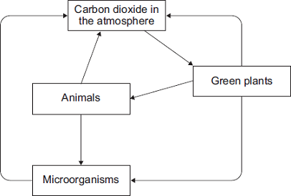
Topic | B17 Organising an Ecosystem
Qu | Explain how ______ is cycled in the environment.
Info | You could be asked how the following is cycled in the environment: Carbon Water Nutrients (if you are doing separate science) To answer this question you will need to do the following: Identify all the different ways in which the substance is moving from one place to another. Describe these processes
Top Tip
Model Answer | Explain how carbon is cycled in the environment. Green plants remove carbon dioxide from the atmosphere by photosynthesis, they also release carbon dioxide into the atmosphere when they respire. When plants are eaten by animals the carbon is transferred from the plant to the animal. When the animal respires carbon dioxide is released into the environment. When both plants and animals die, they are broken down by microorganisms. These microorganisms also respire and release carbon dioxide back into the atmosphere. Finally if plants are burned then carbon dioxide can be released back into the atmosphere in this way also.
Practice | Learn and practice the model answer above. Prepare and learn model answers to explain how water is cycled in the environment and how nutrients are cycled in the environment through decay.
For these questions you will often by given a diagram to help you structure your answer. For example, this is a diagram given for a carbon cycle question. Before you begin label your diagram with key words that describe how the substance is moving from one place to another.

Slide 10
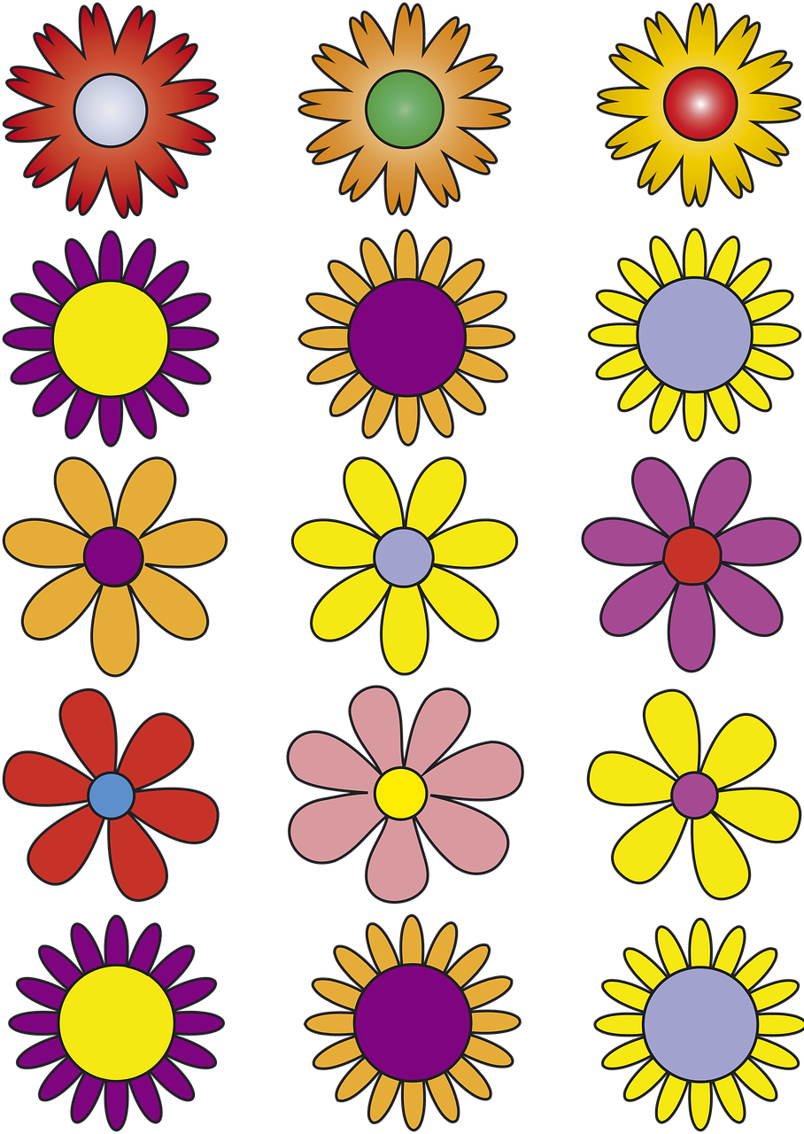

RP7
Sampling
Quadrats
1.
Place 5 quadrats randomly in an area in which conditions of a particular factor are similar. For example, quadrats are placed in high light intensity.
2.
Count the number of the organism growing within that quadrat.
3.
Identify outliers and calculate an average.
4.
Repeat by placing 5 quadrats in contrasting conditions. For example, quadrats are place in an area of low light intensity.
5.
Compare data from the different environments.
Practical Video

Slide 11
RP7
Sampling
1.
Place a tape measure the length of the area being investigated.
2.
Put the quadrat at the 0cm mark and count how many of that organism are within the transect.
3.
Record the abiotic conditions.
4.
Place a quadrat every 5m and count the number of organisms within the quadrat. Record the abiotic factors.
5.
Repeat these steps with 4 more transects.
Transects
Practical Video

Slide 12
RP7: Sampling
Fold page here
Why should quadrats be placed in random positions?
How could you position a quadrat randomly?
When investigating distribution using quadrats how could you ensure results are valid?
When using a transect how could you ensure results are valid?
How could you estimate % cover using a quadrat?
How would you calculate the area of a rectangular field?
What piece of equipment would you use to measure distance?
How could you estimate the number of organisms in a field.
What is a transect?
When would you use a transect?
What sampling technique would you use to approximate the number of plants in a habitat?
To avoid bias.
Throw over shoulder or with eyes shut or use a random number generator to create coordinates.
Repeat using more quadrats.
Repeat using a transect line in a different position
Count the number of squares within the quadrat more than 50% covered, divide by the total number of squares in the grid and multiply by 100.
Measure the length and width and multiply these together.
Measuring tape.
Find the area of the field and the number of organisms found in 1m². Multiply these numbers together.
A line across a habitat.
To investigate a gradual change in a habitat.
Random placement of a quadrat.

Slide 13
Topic | RP7 Sampling
Qu | Plan an investigation to estimate the number of _________growing/living in ________
Info | You could be asked this question to estimate the number of different plants/animals or insects in different habitats. Examples that have been assessed in the past include: Number of ragwort in a field. Dandelions in a field Number of daphnia in a pond. To answer either of these questions you will need to do the following: Describe how to find the area of the habitat. Describe how you will use a quadrat to find the number of organisms in a given area. Explain how you will use your results to estimate the population in the entire area.
Top Tip | Make sure that you include in your method how you will collect valid data. For sampling using quadrats this is lots of repeats, calculating an average and a description of how the quadrat will be placed randomly
Model Answer | Plan an investigation to estimate the number of dandelions growing in a square field. Determine the area of a field. To do this measure the length by the width and multiply these numbers together. Place 10 1m² quadrats randomly in the field and count the number of dandelions in the quadrat. Calculate an average. Multiply the average in 1m² by the total area of the field to find an estimate. To place the quadrat randomly I will split the field into a grid and use a random number generator to create random coordinates.
Practice | Learn and practice the model answer above. Prepare and learn a model answer to estimate the number of daisies in a field with the following shape.

Slide 14
Topic | RP7 Sampling
Qu | Plan an investigation to compare the number of _________growing/living in ________ and ____________
Info | You could be asked this question to compare the distribution of an organisms in different habitats/conditions within that habitat. Examples that have been assessed in the past include: Bluebells growing in fields/woodland Limpets living in a sheltered bay and non sheltered bay. Dandelions growing in full sunlight and in shade. To answer either of these questions you will need to do the following: Describe how you will use a quadrat to find the abundance in each location Describe what you will do with your results.
Top Tip | Make sure that you include in your method how you will collect valid data. For sampling using quadrats this is lots of repeats, calculating an average and a description of how the quadrat will be placed randomly.
Model Answer | Plan an investigation to compare the number of dandelions growing in full sunlight and in a shady woodland. Place 10 1m² quadrats randomly in the field and count the number of dandelions in the quadrat. Repeat this in the shaded area Calculate an average for each each area. Compare the averages from the field in full sunlight and shady woodland to form a conclusion To place the quadrat randomly I will split the sample areas into a grid and use a random number generator to create random coordinates.
Practice | Learn and practice the model answer above. Prepare and learn a model answer to compare the number of limpets on a sheltered shoreline and an exposed shoreline.

Slide 15
Topic | RP7 Sampling
Qu | Plan an investigation to investigate the distribution of _______ using a transect line.
Info | In this question you could be to investigate the distribution of different organisms in different habitats using transects. Examples that have been assessed in the past include: Seaweed along a seashore. Plants growing along a stream. Dandelion distribution. Plants growing along a lake. To answer either of these questions you will need to do the following: Identify where the transect will be placed. Describe the placement of the quadrats. Identify what you will be recording. Identify repeats that you will do in different locations.
Top Tip | When placing quadrats along a transect you will use regular intervals. This is so that you will get data for the position of the organism you are investigating at different distances along the varying conditions of the habitat.
Model Answer | Investigate the distribution of seaweed from the sea up to the rocks. Place a transect line at a right angle from the sea. Place the quadrat at the point closest to the sea. Record the abundance of different seaweeds. Repeat placing the quadrat at regular intervals up the shoreline. Repeat placing the transect several more ties at different positions along the shore.
Practice | Learn and practice the model answer above. Prepare and learn a model answer to investigate the abundance of plants along a stream, from the shore of a lake and the abundance of dandelions from the edge of a woodland.

