Slide 1
Chemistry Paper 2
Model Exam Question Booklet
Chemistry Paper 2
Topics in the Paper:
C8 | Rates and Equilibrium
C9 | Crude Oil and Fuels
C12 | Chemical Analysis
C13 | The Earth’s Atmosphere
C14 | The Earth’s Resources
RP11 | Rates of Reaction
RP12 | Chromatography
Essential Content for the 2022 Foundation Trilogy Science Exam
This booklet is split into 3 parts:
Part 1
The first part is a selection of short response questions and answers that are likely to come in your Chemistry exams this summer. Spend time learning the answers to these questions, for example you could produce flash cards. You should self quiz yourself on these questions regularly!
Part 2
Selection of extended response questions (4 to 6 marks) that are likely to be on your paper this year, either because they have not been assessed in the last couple of years, or because they come up most years in exams. Prepare and practice your responses to these questions.
Part 3
Required practical section. In this section you will find step by step guidance for each practical. This is followed by a page of short response questions and answers to learn for each of the practicals. There are also some extended response questions (4 to 6 marks) that are very likely to be on the exam paper this year.

Slide 2
C8: Rates of Reaction
How can the rate of reaction be found?
What formula would you use if you were finding the rate of reaction by measuring the quantity of reactant used?
What formula would you use if you were finding the rate of reaction by measuring the quantity of product formed?
What factors affect the rate of chemical reactions?
How can we use a gas syringe to calculate the rate of reaction of a reaction in which a gas is formed?
How can we use a balance to calculate the rate of reaction of a reaction in which a gas is formed?
How can we use apparatus to calculate the rate of reaction in which a solid is formed?
What is a precipitate?
What state symbol would you find for a precipitate?
What is collision theory?
What is activation energy?
Why does increasing pressure increase the rate of reaction?
Why does increasing pressure of reacting gases increase the rate of reaction?
Why does increasing surface area of reacting solids increase the rate of reaction?
Why does increasing temperature increase the rate of reaction?
Why does the use of a catalyst increase the rate of reaction?
What is a catalyst?
What symbol represents a reversible reaction?
What is a reversible reaction?
How can the direction of a reversible reaction be changed?
What is equilibrium?
By measuring the quantity of reactant used or the quantity of product formed over time.
Mean Rate of Reaction = Quantity of Reactant Used/Time Taken
Mean Rate of Reaction = Quantity of Product Formed/Time Taken
Concentration of Reactants, Pressure of Reacting Gases, Surface Area of Solid Reactants, Temperature and Presence of Catalysts.
Add the reactants in a conical flask, seal with a bung and collect the gas in a gas syringe. Record how much gas has been made in a given time.
Weigh the reactants beforehand, add them both to a conical flask and record the decrease in mass in a given time.
Add the reactants in a conical flask and time how long it takes for the cross to disappear.
A solid product in a chemical reaction.
(s)
It is a theory that states that chemical reactions can only occur when reacting particles collide with each other and with sufficient energy.
The minimum amount of energy that particles must have to react.
The frequency of collisions between reactants is increased which increases the rate of reaction.
The frequency of collisions between reactants is increased which increases the rate of reaction.
The frequency of collisions between reactants is increased which increases the rate of reaction.
The frequency of collisions between reactants is increased and the collisions are more energetic.
Catalysts provide a different pathway for the reaction that has a lower activation energy.
They are chemicals which change the rate of chemical reactions without being used up themselves.
⇋
It is a reaction in which the products of a reaction can react to make the original reactants.
Changing the conditions.
It is when a reversible reaction occurs in apparatus it can’t escape from and the forward and backward reaction happen at the same rate.

Slide 3
C9: Crude Oil
What is crude oil?
What is a hydrocarbon?
What is the general formula for an alkane?
What is the name of an alkane containing 1 carbon atom?
What is the name of an alkane containing 2 carbon atoms?
What is the name of an alkane containing 3 carbon atoms?
What is the name of an alkane containing 4 carbon atoms?
How can the hydrocarbons in crude oil be separated?
What uses do we have for the fractions of crude oil?
What fuels are produced from crude oil?
What materials are produced by the petrochemical industry?
Why are there lots of natural and synthetic carbon compounds?
What happens during fractional distillation?
What properties of a hydrocarbon depend on its size?
What happens to the flammability of a hydrocarbon as it becomes larger?
What happens to the viscosity of a hydrocarbon as it becomes larger?
What happens to the melting and boiling point of a hydrocarbon as it becomes larger?
What happens during combustion of hydrocarbon fuels?
What is the word equation for combustion of a fuel from crude oil?
How can hydrocarbons be broken down into smaller molecules?
What happens during catalytic cracking?
What happens during steam cracking?
What are the products of cracking?
How can we test for alkenes?
What colour change happens when alkenes react with bromine?
It is a finite resource found in rocks. It is the remaining of ancient biomass made of plankton that was buried in mud. It is a mixture of a large number of compounds which are mostly hydrocarbons.
A compound containing hydrogen and carbon atoms only.
C_{n}H_{2n+2}
Methane
Ethane
Propane
Butane
Fractional Distillation
Fuels and the petrochemical industry.
Petrol, Diesel, Kerosene, Heavy Fuel Oil, Liquified Petroleum Gases.
Solvents, lubricants, polymers, detergents.
The ability of carbon atoms to form families of similar compounds.
The crude oil is heated and evaporates. As the gas rises it cools and condenses at its boiling point where it can then collected.
Flammability, viscosity and boiling points.
Decreases
Increases
Increases
The carbon and hydrogen in the fuel are fully oxidised to make carbon dioxide and water. This releases energy.
Hydrocarbon + Oxygen → Carbon Dioxide + Water
Cracking
The crude oil is vaporised and passed over a hot catalyst.
The crude oil is vaporised and mixed with steam and heated to a high temperature.
Smaller useful alkanes and alkenes.
Add bromine water and if the colour changes to clear an alkene is present.
The orange bromine water turns colourless.

Slide 4
C12: Chemical Analysis
In Chemistry what is a pure substance?
How can you use melting and boiling point to distinguish a pure substance?
In everyday language what is a pure substance?
What is a formulation?
How are formulations made?
What are examples of formulations?
What is chromatography?
What is the rf value?
How is the rf value calculated?
How can rf values be used to identify different compounds?
How can you use chromatography to determine if a substance is a mixture or pure?
A single element or compound not mixed with any other substance.
They will melt and boil at one specific temperature.
A substance that has had nothing added to it and so it is unadulterated and in its natural state.
A mixture that has been designed as a useful product.
Mixing the chemicals in carefully measured quantities to ensure that the product has the required properties.
Fuels, cleaning agents, paints, medicines, alloys, fertilisers and foods.
It is a way of separating mixtures and can be used to identify substances. It involves a mobile phase and a stationary phase.
The ratio of the distance moved by a compound to the distance moved by the solvent
Distance moved by substance / distance moved by solvent.
Different compounds have different Rf values in different solvents.
Pure substances will have a single spot while a mixture will separate into two or more spots

Slide 5
C13: Earths Atmosphere
What is the percentage of nitrogen in our atmosphere?
What is the percentage of oxygen in our atmosphere?
What other gases are in the atmosphere is small proportions?
Why is evidence for the Earth’s early atmosphere limited?
How long ago did the early atmosphere form?
How do we think the Earth’s early atmosphere formed?
How do we think the oceans formed?
What other planets atmospheres may Earth’s have been like in the past?
How do we think nitrogen got into the atmosphere?
What other gases could have been in the early atmosphere is small proportions?
Why did the formation of the oceans cause carbon dioxide levels to decrease?
How is oxygen released into the atmosphere?
What is the word equation for photosynthesis?
What is the formula equation for photosynthesis?
When did algae first appear on Earth?
How long did it take for oxygen levels to build up so that animals could evolve?
Why did the percentage of carbon dioxide decrease further when plants evolved?
What is a major source of atmospheric pollutants?
What gases can be released when a fuel is burned?
Why is sulfur dioxide produced when a fossil fuel is burned?
What is carbon monoxide?
What problems does sulfur dioxide cause?
What problems do nitrogen oxides cause?
What problems do particulates cause?
80%
20%
Carbon dioxide, water vapour and noble gases.
Because it formed so long ago.
4.6 Billion years
Volcanic activity that released gases
As the earth cooled water vapour condensed
Mars and Venus today
Volcanic activity
Methane and ammonia
Carbon dioxide dissolved in water and carbonates precipitated producing sediments.
Photosynthesis
Carbon Dioxide + Water → Glucose + Oxygen
6CO₂ + 6H₂O → C₆H₁₂O₆ + 6O₆
2.7 billion years
A billion years
Photosynthesis removed it from the atmosphere. It became locked in sedimentary locks and in fossil fuels.
Burning fossil fuels.
Carbon dioxide, water vapour, carbon monoxide ,sulfur dioxide and oxides of nitrogen.
The fuels contain some sulfur atoms.
A toxic colourless odorless gas.
Respiratory problems and acid rain.
Respiratory problems and acid rain.
Global dimming and health problems in humans.

Slide 6
C14: Earths Resources
What do we use the Earth’s resources for?
What is sustainable development?
What are finite resources?
What are renewable resources?
What is potable water?
Why is potable water not pure?
What does the method potable water is made depend on?
How is potable water made in the UK?
What can be used to sterilise water?
What method is used to make potable water is fresh water is limited?
What is a problem of desalination?
What produces large amounts of wastewater?
What needs to be removed from wastewater?
What may need to be removed from industrial wastewater?
What happens during sewage treatment?
Warmth, shelter, food and transport
Development that meets the needs of the current generation without compromising the ability of future generations to meet their own needs.
Resources that are used up quicker than they can be replaced, they will run out.
Resources that will not be used up.
Water that is safe to drink
It contains dissolved substances.
Available supplies of water and local conditions.
Rain provides water with low levels of dissolved substances. This collects in the ground and in lakes. This water is passed through filter beds and sterilised.
Chlorine, ozone or ultraviolet light
Desalination using distillation or reverse osmosis.
Needs large amounts of energy.
Urban lifestyles and industrial processes
Removal of organic matter and harmful microbes
Removal or organic matter and harmful chemicals
Screening and grit removal, sedimentation to produce sludge and effluent, anaerobic digestion of sludge and aerobic treatment of effluent.

Slide 7
C8 Rates of Reaction
Describe and explain the effect an increase/decrease in _____ has on the rate of reaction.
You need to be prepared to explain how temperature, pressure, surface area, concentration and the presence of catalysts affect the rate of reaction.
Examples of questions that have come up in the past include:
State and explain the effect that increasing the temperature of the sodium thiosulfate solution has on the rate of the reaction.
State and explain the effect using magnesium powder instead of magnesium ribbon has on the rate of reaction.
Predict the effect of increasing the concentration of hydrochloric acid when you react hydrochloric acid and magnesium carbonate.
To answer a question like these you need to:
Describe the effect. Include within this if there be an increase or decrease in rate of reaction.
Explain why this occurs.
Make sure you link the idea of particles and collisions in your answer.
Describe and explain the effect an increase in temperature would have on the rate of reaction.
If temperature were to increase, then the rate of reaction would increase also. This is because the particles will have more kinetic energy and so will be more likely to collide with each other. Not only are collisions more likely, but when the particles do collide, they are more likely to be colliding with enough activation energy for the reaction to occur.
Learn and practice the model answer above.
Construct and learn model answers for the effect on rate of reaction when there is an increase in pressure, surface area and concentration.
Construct and learn model answers for the effect on rate of reaction when there is an decrease in pressure, surface area and concentration.

Slide 8
C9 Crude Oil
Explain how crude oil is separated by fractional distillation.
Compare cracking and distillation.
Describe what happens when an alkane burns.
Explain how crude oil is separated by fractional distillation
Crude oil is heated and the hydrocarbons vaporise. The vapours enter the fractionating column near the bottom. The column is hotter at the bottom and cooler at the top. The vapours rise up the column and as they do they cool. The hydrocarbon condense to become liquid at their boiling points. Different substances have different boiling points and so the different fractions collect at different levels. The smallest hydrocarbon molecules have lowest boiling points and they collect as gases at top of the column where temperature is lower. Larger hydrocarbons have higher boiling points so collect nearer the bottom where the temperature is higher.
Compare cracking and distillation
Cracking involves a catalyst while distillation does not. Distillation does not involve a chemical change, while cracking does.
Describe what happens when an alkane burns.
When an alkane it combines with oxygen to make carbon dioxide and water. The reaction is exothermic and so releases energy into the environment.

Slide 9
C9 Crude Oil
Describe how crude oil is formed.
Describe and explain the trend in the boiling points of the alkanes.
Explain why cracking is used in the fuel industry.
Describe how crude oil is formed.
Biomass such as plankton is buried in mud and compressed over a long period of time.
Describe and explain the trend in the boiling points of the alkanes.
The bigger the alkane the higher the boiling point. This is because as the molecules get bigger the intermolecular forces between the molecules increase and so it takes more energy for these bong to be overcome when the alkane turns into a gas.
Explain why cracking is used in the fuel industry.
Cracking involves braking large molecules into smaller ones. Large hydrocarbons are not very useful as they do not ignite easily, they are not volatile and they do not easily flow. By braking this larger hydrocarbons into smaller ones we get more useful smaller molecules that can be used as fuels. The smaller molecules are volatile and flow and ignite easily which are ideal properties for a fuel. Alkenes are also produced during cracking which are useful to make polymers.

Slide 10
C12 Chemical Analysis
Explain how paper chromatography causes different pigments to separate.
Plan a chromatography experiment to investigate the colours in an ink.
Explain how you calculate an Rf value for a pigment.
Explain how paper chromatography causes different pigments to separate.
The solvent is the mobile phase and moves through the stationary phase which is the paper. The different pigments have different solubilities in the solvent and have different attractions for the paper. This means that the different pigments are carried different distances and so separate.
Plan a chromatography experiment to investigate the colours in an ink.
You would put dots of known colours, and a dot of the ink on the pencil origin line on the chromatography paper. The bottom of the paper would then be placed in water, making sure the start line is above the water. The solvent would then be left to rise up through the paper. When the solvent is near the top of the paper, the paper will be removed and leave to dry. You would then compare positions of dots for known colours with those from the ink.
Explain how you calculate an Rf value for a pigment.
You would use the formula Rf Value = Distance moved by pigment / Distance moved by solvent. You would then need to measure how far the pigment moved measuring from the origin line to the centre of the spot of the pigment and measure from the origin line to the solvent front. Both of these measurement's should be in the same unit. You would then divide the distance moved by the pigment by the distance moved by the solvent. This will give you an Rf value which should be a number less than 1.

Slide 11
C13 The Earth’s Atmosphere
Explain the problems that increased CO₂ in the atmosphere can cause.
Describe the processes which remove CO₂ from the atmosphere.
Explain how plants and other organisms have changed the atmosphere.
Compare the Earth’s early atmosphere to the atmosphere today.
The Earth’s early atmosphere was a large amount of carbon dioxide, lots of water vapour, no oxygen and trace amounts of methane, ammonia and nitrogen.
Today there is only trace amounts of carbon dioxide and water, while most of the atmosphere (78%) is nitrogen. Oxygen is also now present in the atmosphere and makes up 21%. There are still trace amounts of methane and ammonia present, but there is less of them.
Describe the processes which remove CO₂ from the atmosphere.
Plants take in carbon dioxide and it is converted to glucose and starch in a process called photosynthesis. The carbon dioxide can then become locked up in fossil fuels. The carbon dioxide in the atmosphere can also dissolve in sea water and produce hydrogencarbonates. Marine animals use carbonates to make shells and over time these shells form sedimentary rocks.
Explain how plants and other organisms have changed the atmosphere.
Plants take up CO₂ and release oxygen through photosynthesis. When they die carbon dioxide becomes trapped in rocks and fossil fuels. The oxygen then went on to react with other molecules. Oxygen molecules reacted together to form ozone and methane and ammonia also reacted with oxygen as its levels increased in the atmosphere. Nitrogen gas was produced by reaction between oxygen and ammonia. Denitrifying bacteria also produced nitrogen gas. The nitrogen builds up in the atmosphere because it is unreactive.

Slide 12
C13 The Earth’s Atmosphere
Identify and explain the changes that have occurred since the Earth’s early atmosphere.
This question (or part of it) is a frequent long response question found on a Chemistry Paper 2. The examiner may provides charts or diagrams to interpret as part of the question. You may need to use the data they give; however, this question will mostly be looking for you to apply your knowledge.
Examples of questions in the past include:
Describe and explain how the atmosphere today is different from the atmosphere of billions of years ago.
Describe and explain how the surface of the early Earth and its atmosphere have changed to form the surface of the Earth and its atmosphere today.
Explain what has happened to most of the water vapour in the Earth’s early atmosphere.
Describe how the evolution of plants changed the Earth’s atmosphere.
Describe two processes which reduced the proportion of carbon dioxide in the Earth's atmosphere over the period of three billion years.
Suggest what has caused the main gases in the Earth’s atmosphere of millions of years ago to change to the present-day atmosphere.
Use a clear structure in your answer. Identify a gas in the Earth’s early atmosphere, identify if there is now more or less in the atmosphere and explain why. Repeat this for each gas.
Describe and explain how the atmosphere today is different from the atmosphere of billions of years ago.
In today’s atmosphere there is less carbon dioxide. This is because it has been absorbed by plants during photosynthesis and become locked in fossil fuels. It has also dissolved into oceans and become locked in rocks.
Today there is much more oxygen in the atmosphere. This is because when plants evolved and started to photosynthesise oxygen was released.
Today there is also much more nitrogen. This has been produced by the decay of organisms and the breakdown of ammonia. Nitrogen is unreactive and so has accumulated over time.
Today there is less water vapour. This is because when the Earth cooled the water vapour condensed and formed oceans.
Learn and practice the model answer above.
Construct and learn model answers for questions 2 -6.

Slide 13
C14 The Earth’s Resources
Explain and justify the steps to treat water from reservoirs.
Explain when seawater is used as a source of water for making potable water
Describe how sewerage is treated.
Explain and justify the steps to treat water from reservoirs.
The reservoir water would first be filtered. Filtering would remove solids such as small insoluble particles. The water would then have a chemical such as chlorine added to it. This would be to sterilise the water and reduce the number of microbes that was in it.
Explain when seawater is used as a source of water for making potable water
Seawater is used as a source of water for making potable water when there is not a sufficient supply of ground water available. This is because to make seawater safe to drink you would need to desalinate the water, either by reverse osmosis or distillation which are both more expensive to do as they require large amounts of energy.
Describe how sewerage is treated.
First the sewerage passes through a metal grid which removes the large debris and substances such as grit. This processes is known as screening. The screened sewerage is then left for sedimentation to occur. The heavier substances will sink to the bottom and form a layer of sludge while the liquid layer above is the effluent. The sludge is piped away any broken down by microbes anaerobically while the effluent is broken down aerobically in another tank by microbes. The water is then sterilised to kill off any pathogens.

Slide 14
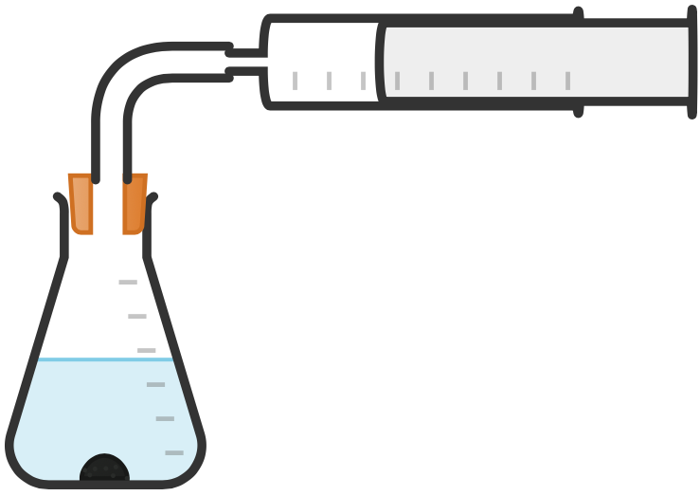

RP11
Rate of Reaction
Method when at least one of the products is a gas...
When Method Used | When a gas is made.
Outline Method | Set up experiment as shown in diagram. Add 10 g of ____________ into the flask. Add 50 cm³ of _____________, connect the gas syringe and start a timer.
What is Measured (Dependent Variable) | Total volume of gas made in 1 minute. OR Volume of gas every 10 seconds for 1 minute.
Possible Variables | Surface Area of Reactant Mass of Reactant Concentration of Acid Temperature of Reactants
Delivery Tube
Gas Syringe
Practical Video
Conical Flask

Slide 15
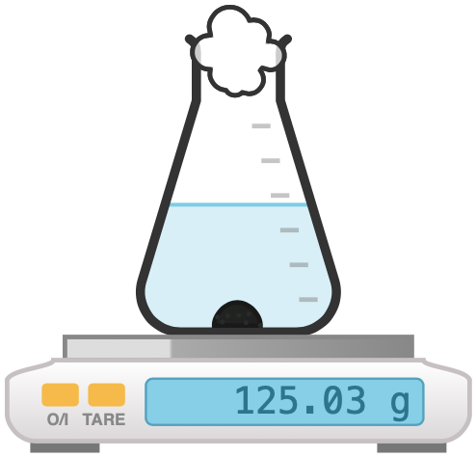
RP11
Rate of Reaction
Alternative method when at least one of the products is a gas...
When Method Used | When a gas is made.
Outline Method | Set up experiment as shown in diagram. Add 10 g of _________ into the flask. Add 50 cm³ of ___________ and start a timer.
What is Measured (Dependent Variable) | Total mass of gas lost in 1 minute. OR Mass every 10 seconds for 1 minute.
Possible Variables | Surface Area of Reactant Mass of Reactant Concentration of Acid Temperature of Reactants
Cotton Wool
Conical Flask
Balance
Practical Video

Slide 16
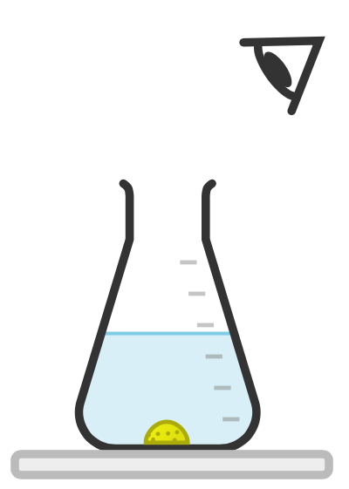
RP11
Rate of Reaction
Method when one of the products is a solid...
When Method Used | When a solid (precipitate) is made.
Outline Method | Put 50 cm³ of sodium thiosulfate solution into a container. Put the container on a cross drawn on a piece of paper. Add 5 cm³ of dilute hydrochloric acid and start timing.
What is Measured (Dependent Variable) | Time it takes for the cross to disappear.
Possible Variables | Concentration/Volume of Sodium Thiosulfate Concentration/Volume of Acid Temperature of Reactants
Conical Flask
Practical Video
Black cross drawn on paper

Slide 17

RP11: Rate of Reaction
Fold page here
What is rate of reaction?
What is turbidity?
What apparatus would you need to measure mass?
What apparatus would you need to measure time?
What apparatus would you need to measure temperature?
What apparatus would need to measure volume?
What would be the most accurate way of measuring 25cm³ of liquid?
What are the possible dependent variables if you were investigating the rate of reaction?
When would you measure rate of reaction by their measuring the volume of gas produced or decrease in mass?
When would you measure the rate of reaction by measuring the time taken for a cross to disappear?
How can you tell from a symbol equation if the solution is going to turn cloudy?
How can you calculate rate of reaction at a specific time?
When investigating the rate at which a precipitate forms why should the same person should look at the black cross?
What does the word reproducible mean?
What does the word repeatable mean?
If you are investigating the effect of a particular factor on the rate of reaction what are the possible variables, one you could change, and the others you would need to keep the same?
How could results when investigating rates of reaction be made more accurate?
It is how fast a reaction occurs.
The cloudiness of a solution due to the presence of particles invisible to the eye that are suspended in the fluid.
Balance
Stop clock
Thermometer
Measuring cylinder
Use a pipette or burette.
Volume of gas made, decrease in mass or time it takes for a cross to disappear.
When at least one of the products is a gas and has the state symbol (g) after it.
One of the products will be a solid and will have the state symbol (s) after it.
When one of the products is a solid and has the state symbol (s) after it.
Draw a tangent to the curve and calculate the gradient using: difference in y-axis/ difference in x-axis.
Different people may decide that they cannot see the cross at different amounts of cloudiness which can lead to errors deciding when to take the reaction time.
If the experiment is repeated by another person, the same results are obtained.
If the experiment is repeated by the same person and the same results are obtained.
Concentration of reactants, volume/mass of reactants, surface area of reactants, temperature of reactants, pressure of reactants, presence of a catalyst.
Repeat the experiment twice more, discard any outliers and calculate a mean.

Slide 18
Practical | RP11 Rates of Reaction Practical
Qu | Plan an investigation to show how ______________________ affects the rate of the reaction with _________________________.
Info | You could be asked this question for different practical's. Some that have come up in the past include: The concentration of the sodium thiosulfate solution reacting with hydrochloric acid. The temperature of the sodium thiosulfate solution reacting with hydrochloric acid. The mass of marble chips reacting with hydrochloric acid. To answer this question you will need to do the following: Construct a diagram of the equipment. Describe how you will collect results. Identify what you will measure. Identify repeats you will do. If you are investigating the effect of a variable you will need 5. Identify what you will control.
Top Tip | Your method needs to produce valid results. This means you need to clearly identify what you are changing and measuring and what you are going to control.
Model Answer | Plan an investigation to show how the concentration of the sodium thiosulfate solution affects the rate of the reaction with dilute hydrochloric acid. Measure 25cm³ of sodium hydroxide using a measuring cylinder and add to a conical flask. Measure out 100cm³ hydrochloric acid and add it to the conical flask. Place the flask on a piece of paper with a black cross and time how long it takes for the cross to disappear. Repeat this two more times to identify outliers and calculate an average. Repeat with 5 different concentrations of sodium thiosulfate. I will control the concentration and volume of sodium thiosulfate and hydrochloric acid.
Practice | Learn and practice the model answer above. Prepare and learn model answers to investigate the effect of temperature, surface area and mass on the rate of reaction.

Slide 19
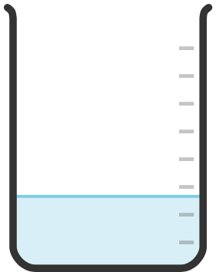

RP12
Chromatography
Draw a horizontal origin pencil line 2cm from a short edge of the chromatography paper.
Use a glass capillary tube to put a small spot of each of the samples onto the paper.
Add the solvent to a beaker and place the chromatography in making sure that the origin line is above the water level.
Wait for the solvent to travel up to the top of the chromatography paper.
Remove the paper.
Let the paper dry.
Measure the distance the solvent moved. This is the solvent front.
Measure the distance the substances in the samples travelled this is the solvent front.
Calculate the Rf Value.
Chromatography Paper
Sample
Practical Video
Origin Line
Beaker
Solvent

Slide 20
RP12: Chromatography
Fold page here
What is chromatography?
What is Rf value?
What is the mobile phase?
What is typically used for a mobile phase?
What will you need to do if a sample does not dissolve in water?
What is the stationary phase?
What is used for the stationary phase?
What can chromatography be used for?
How does chromatography work?
Why is pencil used to draw an origin line?
Why must the origin line be placed above the water level?
How can you determine that a substance is pure from a chromatogram?
How can you determine that a substance is a mixture from a chromatogram?
How can you tell how many substances there are in a mixture using chromatography?
How do you calculate the Rf value?
What is the solvent front?
Why are different dyes separated during chromatography?
The process whereby small amounts of dissolved substances are separated by running a solvent along a material such as absorbent paper.
A measurement from chromatography. It is the distance a spot of a substance has been carried above the baseline divided by the distance of the solvent front.
The phase the moves during chromatography. This is the solvent.
Water or ethanol.
Use ethanol instead.
The phases that does not move during chromatography paper.
Chromatography paper
Separate and identify substances in mixtures.
The mobile phase moves through the stationary phase. A substance with stronger forces of attraction between itself and the mobile phase will be carried a greater distance in a given time.
It is insoluble and so will not move during chromatography.
So that the soluble substances do not just dissolve into the water.
There would only be 1 ink spot.
There would be more than 1 ink spot for each sample.
Count the number of spots.
Rf Value = Distance moved by colour / Distance moved by solvent.
The distance the solvent travelled.
The solvent moves through the paper and different dyes have different solubilities and different attractions to the paper and so are carried different distances.

Slide 21
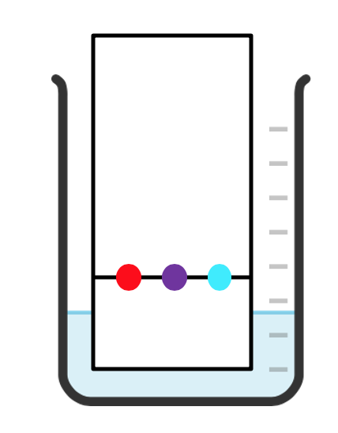
Practical | RP12 Chromatography
Qu | Plan an experiment to identify the colours in an ________.
Info | You could be asked this question for lots of different substances. Some that have come up in the past include: Inks Paint Food colouring Additives Drugs To answer this question you will need to do the following: Draw a labelled diagram of your equipment to show how equipment should be set up Describe how you would carry out your experiment. Describe what measurements you would take. Describe what you would do with these measurements.
Top Tip | Be clear how you will use the Rf values to identify an unknown substance. You need to describe how to find the Rf value and then that you will match this to a known sample.
Model Answer | Plan a chromatography experiment to investigate the colours in an ink.
Practice | Learn and practice the model answer above. Prepare and learn model answers to determine if a drink contained banned food colourings.
I would set my equipment up as shown in the diagram. I would place dots of known colours and a dot of the unknown ink on the pencil line using a capillary tube. I would place the bottom of the chromatography paper in the solvent (water) making sure the pencil line was above the solvent. I would then leave it for the solvent to rise up the paper approximately three quarters of the way. I would then remove the chromatography paper and mark where the solvent reached up the paper. I would measure the solvent front and the distance the sample moved to calculate the Rf value. If the substance has an Rf value that matches a known sample, it can be identified.

