Slide 1
Physics Paper 1
Model Exam Question Booklet
Physics Paper 1
Topics in the Paper:
P1 | Energy stores and transfers
P3 | Energy resources
P4 | Electric circuits
P6 | Particle model of matter
P7 | Radioactivity
RP14 | Specific Heat Capacity
RP16 | Investigating I-V Characteristics
Essential Content for the 2022 Foundation Trilogy Science Exam
This booklet is split into 3 parts:
Part 1
The first part is a selection of short response questions and answers that are likely to come in your Physics exams this summer. Spend time learning the answers to these questions, for example you could produce flash cards. You should self quiz yourself on these questions regularly!
Part 2
Selection of extended response questions (4 to 6 marks) that are likely to be on your paper this year, either because they have not been assessed in the last couple of years, or because they come up most years in exams. Prepare and practice your responses to these questions.
Part 3
Required practical section. In this section you will find step by step guidance for each practical. This is followed by a page of short response questions and answers to learn for each of the practicals. There are also some extended response questions (4 to 6 marks) that are very likely to be on the exam paper this year.

Slide 2

P1: Energy Conservation
Fold page here
What is a system?
What happens in terms of energy when an object is projected upwards?
What happens in terms of energy when a moving object hits an obstacle?
What happens in terms of energy when an object is accelerated by a constant force?
What happens in terms of energy when a vehicle is slowing down?
What happens in terms of energy when water is brought to the boil in an electric kettle?
What is the formula for kinetic energy?
What is the unit for kinetic energy?
What is the unit for mass?
What is the unit for speed?
What is the unit for elastic potential energy?
What is the unit for spring constant?
What is the unit for extension?
What is the formula for gravitational potential energy?
What is the unit for GPE?
What is the unit for gravitational field strength?
What is the unit for height?
What is the definition of power?
What formula would you use to calculate power if you had a value for energy transferred?
What formula would you use to calculate power if you had a value for work done?
What is the unit for power?
What is the unit for energy transferred?
What is the unit for time?
What is the unit for work done?
What is an energy transfer of 1 joule per second equal to?
Object or group of objects.
It gains gravitational potential energy and kinetic energy decreases.
The kinetic energy is transferred to heat and sound and kinetic energy of the obstacle that was hit.
Work is done by a force on an object. This work is converted to the object's kinetic store.
The kinetic energy of the vehicle decreases while energy is dissipated through heat and sound.
Energy transfers from the electrical store of the mains power supply to the thermal store of the water.
Kinetic Energy = 0.5 x mass x (speed)²
Joules, J
Kilograms, Kg
Metres per second, m/s
Joules, J
Newtons per metre, N/m
Metres, m
GPE = mass x gravitational field strength x height
Joules, J
Newtons per kilogram, N/kg
Metres, m
The rate at which energy is transferred or the rate at which work is done.
Power = Energy Transferred / Time
Power = Work Done / Time
Watts, W
Joules, J
Seconds, s
Joules, J
1 watt

Slide 3
P3: Energy Resources
Fold page here
What are the main energy resources available for use on Earth?
What are the three fossil fuels?
What is renewable energy?
What is non-renewable energy?
What uses to we have for energy resources?
What are examples of renewable energy resources?
What are examples of non-renewable energy resources?
How is electricity generated through wind?
What are the advantages of wind turbines?
What are the disadvantages of wind turbines?
What are the advantages of tidal turbines?
What are the disadvantages of tidal turbines?
How is electricity generated through geothermal energy?
What is geothermal energy?
What is nuclear energy?
What is the energy source biofuel?
How is electricity generated through hydroelectricity?
What are the advantages of hydroelectricity?
What are the disadvantages of hydroelectricity?
How is water heated to generate electricity in a solar thermal power station?
What are the advantages of nuclear fuel?
What are the disadvantages of nuclear fuel?
Fossil fuels, nuclear, biofuel, wind, hydroelectricity, geothermal, tidal, sun and water waves.
Coal, oil and natural gas.
A resource that is replenished as it is used.
A resource that is used faster than it can be replenished. It will run out eventually.
Transport, electricity generation and heating.
Biofuel, wind, hydroelectricity, geothermal, tidal, wave and the sun.
Coal, oil, natural gas and nuclear.
The wind has kinetic energy which turns the blades on a wind turbine. The turbine turns and this turns a turbine.
Renewable, conserves fossil fuels, no release of pollutant gases, does not contribute to global warming.
Noise pollution, visual pollution, kills birds, don’t work when it’s not windy.
Renewable, conserves fossil fuels, no release of pollutant gases, does not contribute to global warming.
Noise pollution, visual pollution, kills fish, low power output.
Cold water is pumped into the ground and is heated by hot rocks. The water returns to the surface as stem. The moving steam turns a turbine which turns a generator.
Energy from the Earth’s core is used to heat water.
Fission of uranium nuclei which is used to heat water.
Gases from rotting plant material are burned to heat water.
Water in high level reservoir stores gravitational potential energy. The water flows downhill and has kinetic energy. The water turns a turbine connected to a generator.
Renewable, conserves fossil fuels, no release of pollutant gases, does not contribute to global warming, constant reliable power.
Noise pollution, visual pollution, kills fish, low power output.
Water is heated in a boiler which turns into steam. The steam turns a tribune which turns a generator.
Produces no greenhouse gases, higher energy density in fuel and a longer operating life.
Produce radioactive waste, possibility of accidents, long start up time and high decommissioning costs.

Slide 4
P4: Electric Circuits
Fold page here
What is the definition of electrical current?
What is the equation that links charge, current and time?
What is the unit for charge flow?
What is the unit for current?
What Is the unit for time?
Give the equation that links potential difference, current and resistance.
What is the unit for potential difference?
What is the unit for resistance?
What’s the difference between a series and a parallel circuit?
What does Ohm’s law say?
What happens to the resistance of a filament lamp as the temperature increases?
What happens to the resistance of a thermistor as it increases in temperature?
What happens to the resistance of a LDR as the light intensity increases?
In what diode can the current flow through a diode?
Name an application of an LDR.
Name an application of a thermistor.
Electric current is the rate of flow of charge.
Q = I × t
Coulombs, C
Amperes, A
Seconds, s
V = I × R
Volts, V
Ohms, Ω
A series circuit has only one path for the current to flow; a parallel circuit has more than one.
The current through an ohmic conductor (at a constant temperature) is directly proportional to the potential difference across the resistor.
As the temperature increases, the resistance of a filament lamp also increases.
The resistance decreases as the temperature increases.
The resistance decreases as the light intensity increases.
Current can only flow one way through a diode.
In sensing circuits such as lights turning on when dark
Thermostat

Slide 5
P6: Particles and Matter
Fold page here
What is the equation for density?
What are the units for density?
What are the units for mass?
What are the units for volume?
How are the particles in a solid arranged?
How are the particles in a liquid arranged?
How are the particles in a gas arranged?
How are changes in state different to chemical changes?
Which state of matter is most dense?
What are the names of the five state changes?
How do you measure the volume of a regular solid.
How do you measure the volume of an irregular solid.
ρ = m ÷ V
kg/m³
kg
m³
The particles are touching and vibrate around a fixed pattern.
Particles are touching but not in fixed positions. They are free to flow around.
Particles are far apart and move around quickly and randomly.
The material recovers its original properties if the change is reversed.
Solid.
Melting (solid → liquid), evaporating (liquid → gas), freezing (liquid → solid), condensing (gas → liquid), sublimating (solid → gas/gas → solid).
Measure the length of the three sides and multiply together.
Place the irregular solid in water in a measuring cylinder. Measure how much the water level has gone up by.

Slide 6
P7: Radioactivity
Fold page here
What is radioactive decay?
What is activity?
What is the unit for activity?
What is count rate?
What is an alpha particle?
What is a beta particle?
What is a gamma ray?
What is the penetrating power of an alpha particle?
What is the penetrating power of a beta particle?
What is the penetrating power of gamma radiation?
What is an alpha particles range in air?
What is a beta particles range in air?
What is the range of gamma radiation in air?
What is the ionising power of alpha particles?
What is the ionising power of beta particles?
What is the ionising power of gamma radiation?
What is a use of alpha radiation?
What is a use of beta radiation?
What is a use of gamma radiation?
What happens during alpha decay?
What happens during beta decay?
What is half life?
What is contamination?
What is irradiation?
The random process by which the nucleus gives out radiation to become stable..
The rate at which a source of unstable nuclei decay.
Becquerel, Bq
The number of decays recorded each second by a detector
A helium nucleus which is two neutrons and two protons.
A high-speed electron ejected from the nucleus as a neutron turns into a proton.
Electromagnetic radiation from the nucleus.
Weak, blocked by skin and paper
Blocked by a thin sheet of aluminium.
Able to pass through most materials except thick concrete and lead.
Up to 5cm
Up to 1m
Long distances
Most ionising
Less ionising than alpha, more ionising than gamma
Least ionising
Smoke detectors
Medical tracers and monitoring thicknesses off materials.
Sterilising medical equipment and food
A helium nucleus is released and so the mass and charge of the nucleus decrease.
An electron is released. The mass of the nucleus does not change while the mass increases.
The time it takes for the number of nuclei of the isotope in a sample to half.
The unwanted presence of materials containing radioactive atoms on other materials.
The process of exposing an object to nuclear radiation. The irradiated object does not become radioactive.

Slide 7
P1 Energy Conservation
Describe the energy transfer for a ____.
You could be asked this question for a range of scenarios including:
A falling object
A car driving uphill
A catapult
A pendulum
To answer this question, you will need to do the following:
Identify the input energy
Identify the output energy
Identify the wasted energy
Describe the overall energy change
If you are describing energy “wasted” as heat, make sure you say where it is going – e.g., heating the surrounding air.
Describe the energy transfers for a falling object
For a falling object the input energy is gravitational potential energy. As the object falls the gravitational potential energy decreases.
The gravitational potential energy is transferred into kinetic energy and so as the object falls, and the gravitational potential energy decreases the kinetic energy of the object increases.
Some of the energy is wasted as heat to the surroundings due to air resistance.
Overall, the gravitational potential energy is transferred into kinetic energy.
Learn and practice the model answers above.
Prepare and learn model answers to describe the energy transfers for a car driving uphill, a catapult and a pendulum.

Slide 8
P3 Energy Resources
Evaluate the use of _________ to generate electricity.
You could be asked to evaluate any of the energy resources that you learned about in the topic including including fossil fuels, nuclear, biofuels, wind, solar, hydroelectric, geothermal, wave and tidal.
To answer this question, you need to:
Describe the process used to generate electricity for the energy resource in one clear sentence.
Describe the advantages.
Describe the disadvantages.
When discussing the advantages and disadvantages consider the reliability of the energy resource, if it is renewable or not as well as its impact on the environment
Evaluate the use of fossil fuels to generate electricity.
In a fossil fuel power station a fuel is burned, this turns water into steam which turns a turbine to generate electricity.
The advantages of a fossil fuel power station include that is has a high energy output and it is a reliable energy source.
The disadvantages of using fossil fuels include that it uses a non-renewable energy resource and it produces carbon dioxide which is a greenhouse gas.
Learn and practice the model answer above.
Evaluate the use of nuclear power stations.
Evaluate the use of wind turbines.
Evaluate the use of solar energy.
Evaluate the use of hydroelectric.

Slide 9
P4 Electric Circuits
Calculating a value using the equations:
Charge Flow = Current × Time OR P.D= Current × Resistance
There is frequently a question in which you will need to use these formulas. Marks vary between 3 and 6 marks depending on how much processing of the information you need to do. If you need to use both formulas to answer the question this will usually be worth 6 marks.
To answer this question, you will need to do the following:
Check for any unit conversions you may need to do.
Write down the formula you will be using.
Substitute in the values.
Rearrange.
Do the calculation.
Round to the correct number of significant figures.
Add units.
You do not need to learn these formulas as they will both be given on a data sheet this year. Always write down the formula you are using, substitute numbers and then rearrange. Avoid writing a rearranged formula as its easy to make mistakes and can lose you marks.
Calculate the resistance when there is a potential difference of 3.22 V and a current of 2.18 A
- | Check for unit conversions.
P.D= Current × Resistance | Formula to be used.
3.22 = 2.18 x Resistance | Substitute values.
3.22 / 2.18 = Resistance | Rearrange.
1.4770642202 = Resistance | Do the calculation
1.48 | Round to correct number of sig fig.
1.48Ω | Answer with units

Slide 10
P4 Electric Circuits
Practice using the formulas for charge flow and potential difference by answering the questions below:
A set of lights consists of 20 lamps connected in series to the 230 V mains electricity supply. When the lights are switched on and working correctly, the current through each lamp is 0.25 A. Calculate the charge passing through one of the lamps in 5 minutes.
A 1.7A bulb works at normal brightness for 30 seconds before it is switched off. Calculate the charge that flows through the bulb in the 30 seconds before it is switched off. Give the unit.
The current in the wire was 0.50 A. The mean potential difference across the wire was 0.32 V. Calculate the resistance.
Calculate the charge flow when there is a current of 0.50 A in the wire for 17 s.
Determine the resistance of the lamp when the current in the lamp is 0.22 A and the potential difference is 5V.

Slide 11
P6 Particles and Matter
Identify and explain the properties of _________________
You could be asked this question for solids, liquids and gases. To answer this question, you need to:
Describe its shape and if it can flow
Link the state of matters shape and ability to flow to the forces of attraction between the particles.
Describe its density and if it can be squashed or compressed.
Link the density and ability to be compressed of the state of matter to the closeness of the particles.
Link the properties of the states of matter to the arrangement of particles.
Identify and explain the properties of a gas.
A gas can flow and will completely fill a container that they are in.
This is because there are very little forces of attraction between the molecules and so they are able to move freely.
A gas has a very low density and can be squashed and compressed.
This is because the particles are very far apart and so there is lots of space between them.
Learn and practice the model answer above.
Prepare and learn model answers to identify and explain the properties of solids and gases.

Slide 12
P7 Radioactivity
Explain how the properties of ____ radiation affect the level of hazard at different distances.
You could be asked this question alpha, beta or gamma radiation. To answer this question, you need to:
Describe how penetrating the radiation is
Describe the range of radiation.
Describe the ionising power of radiation.
Describe the risk at a short range and give a reason why
Describe the risk at a long range and give a reason why
The examiner may not use the key terms alpha, beta or gamma but use the symbols 𝛼 ,β, 𝛾 watch out for this.
Be clear in your work how far the radiation can travel and what materials it is unable to penetrate.
Explain how the properties of alpha radiation affect the level of hazard at different distances.
Alpha radiation is the least penetrating and is unable to pass through a sheet of paper.
It also has the least range in air and can only travel 5cm through the air.
Alpha radiation is the most ionising.
At a short range alpha radiation is very dangerous because of how ionising it is.
At a long range alpha radiation is not dangerous because it does not have a long range.
Learn and practice the model answer above.
Prepare and learn model answers to explain how dangerous beta and gamma radiation are at different distances.

Slide 13



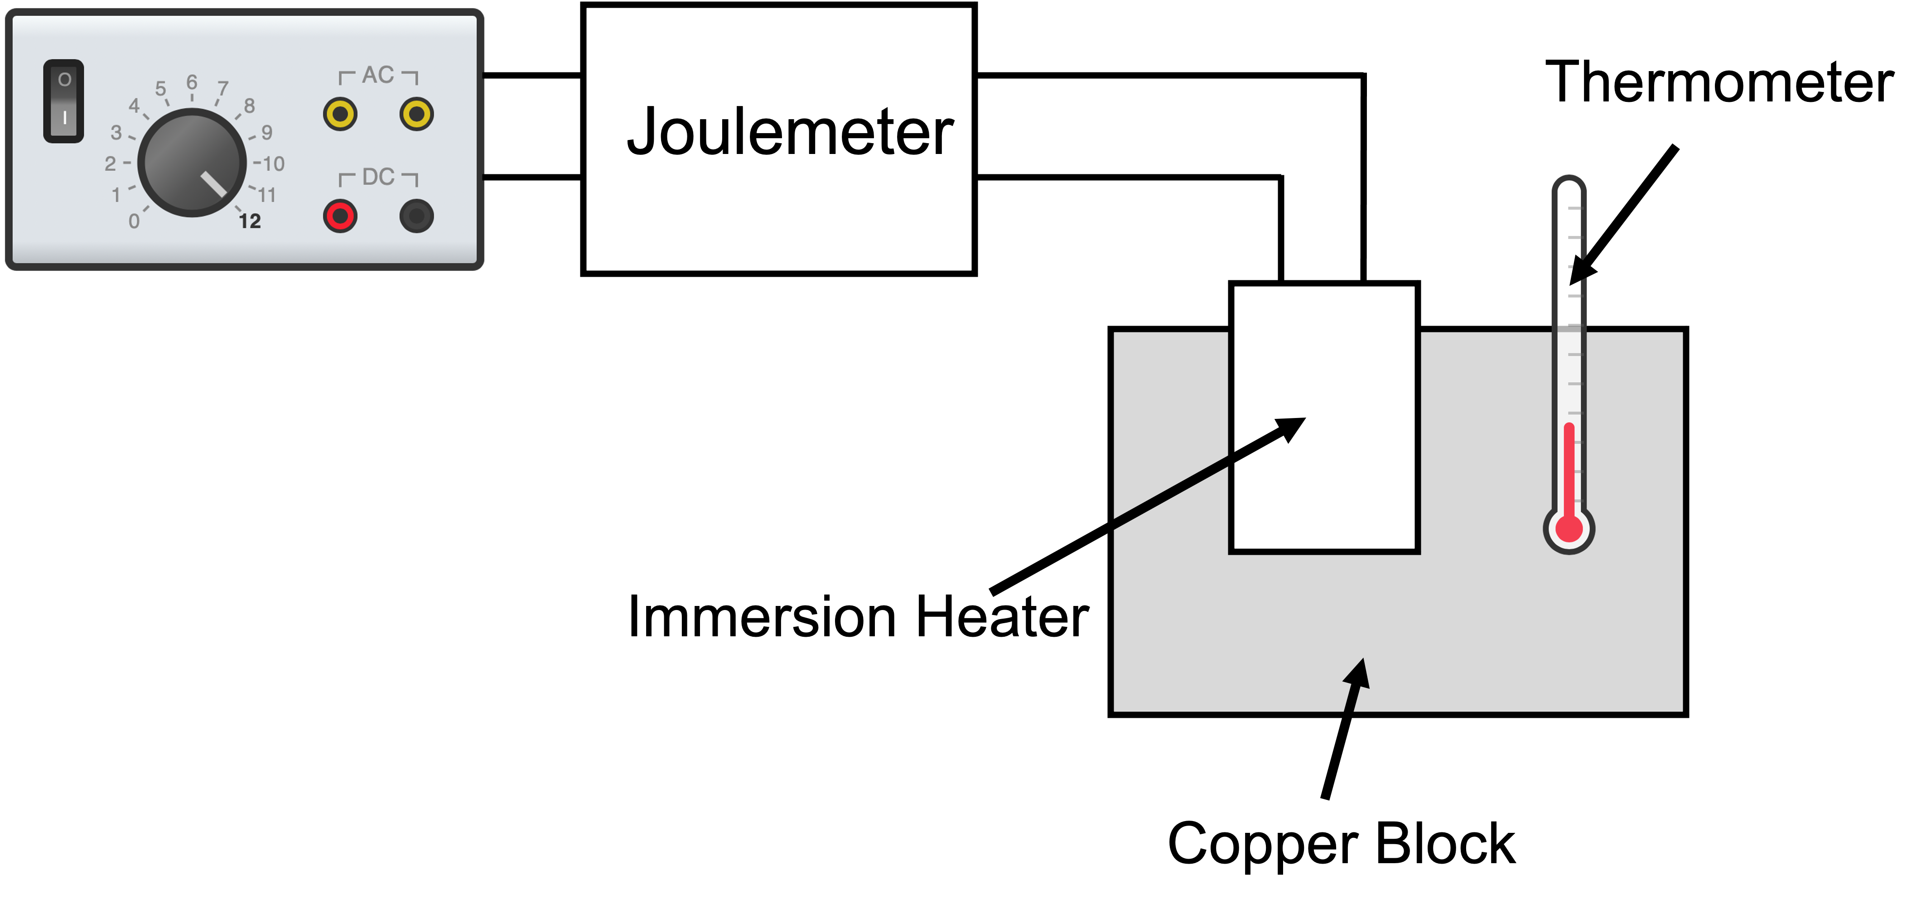
RP14
Specific Heat Capacity
1
Measure and record the mass of the metal block
2
Set up the equipment as shown in the diagram below.
3
Record the start temperature, turn the power pack on and start the timer.
4
Record the temperature and energy transferred after 10 minutes.
5
Calculate the temperature change.
6
Use the mass, temperature change and energy transferred to calculate specific heat capacity.

Slide 14
RP14: Specific Heat Capacity
Fold page here
What piece of equipment do you use to measure mass?
What piece of equipment do you use to measure temperature?
What piece of equipment do you use to make the energy transferred?
What piece of equipment do you use to heat a metal block?
What piece of equipment do you use to measure time?
What unit is energy transferred measured in?
What unit is temperature measured in?
What unit is mass measured in?
Why may the result you obtain for specific heat capacity be different to the true value?
Why should the material the SHC is being determined for be insulated?
When determining SHC of a material what variables should be controlled?
What is specific heat capacity?
What could be used to insulate the metal block?
What measurements do you need when calculating specific heat capacity?
What piece of equipment do we use as a power supply when determining SHC?
What voltage should a powerpack be set to when determining SHC?
What are the possible risks when using the heater?
Balance
Thermometer
Joulemeter
Heater
Stopwatch
Joules
°C
Kilograms
Heat loss, turned off power supply too early, incorrectly measured mass of substance, incorrectly measured temperature, incorrectly measured energy transferred.
Prevents heat loss and so the specific heat capacity will be more accurate.
Mass of the block, dimensions of the block, material of the block, current through heater, thickness of insulation, material of insulation, starting temperature and time interval.
The amount of energy required to raise the temperature of one kilogram of the substance by one degree Celsius.
Bubble wrap, cotton wool.
Mass, temperature change, energy supplied.
Powerpack
12V
Burns.

Slide 15
RP14 Specific Heat Capacity
Explain how to determine the specific heat capacity of _________.
You could be asked this question for different metals and liquids. Some that have come up in the past include:
Copper Block
Oil
To answer this question, you will need to do the following:
Describe how to set up equipment.
Identify the measurements you will make
Identify control variables.
Describe how you will use your results.
Use the formula for specific heat capacity on the data sheet you have been given for your writing frame.
Explain how to determine the specific heat capacity of an iron block.
Measure the mass of the block by using a balance.
Add a heater to the block and connect this to a powerpack that is connected to a joulemeter.
Add a thermometer and record the start temperature.
Turn the powerpack on.
After 10 minutes turn the powerpack off, record the energy transferred and the temperature.
Calculate specific heat capacity of the block using formula change in thermal energy = mass × specific heat capacity × temperature change
Control the material and thickness of the insulation wrapped around the block.
Learn and practice the model answer above.
Prepare and learn model answers to explain how to determine the specific heat capacity of a copper block and a beaker of oil.

Slide 16
P2 Energy Transfer
Describe an experiment to find the specific heat capacity of a metal.
What are the control variables when finding specific heat capacity of a metal?
Explain why the metal should be wrapped in wool when finding SHC
Describe an experiment the student could do to measure the specific heat capacity of a metal.
Measure the mass of metal using a balance. Use an immersion heater to heat the block and fully insulate the block by wrapping it in cotton wool. Record the start temperature of the block and connect the heater to the power supply. Use an energy meter (joulemeter) to measure the energy supplied to the block as it is warmed. Once you have finished warming the block record the energy supplied and the change in temperature Now that you have the mass, temperature change and energy transferred use these values to calculate specific heat capacity.
What are the control variables when finding the specific heat capacity of a metal?
The control variables when determining the specific heat capacity of a metal include the mass of the block, the size of the block and the material of the block. Other control variables include the thickness and material of the insulation as well as the starting temperature of the block, time the block is heated for and the current through the heater.
Explain why the metal should be wrapped in wool when finding SHC
The wool acts as an insulator and prevents the loss of heat. This would lead to a much more accurate value for specific heat capacity. Without insulation the specific heat capacity value that you would find would be bigger.

Slide 17
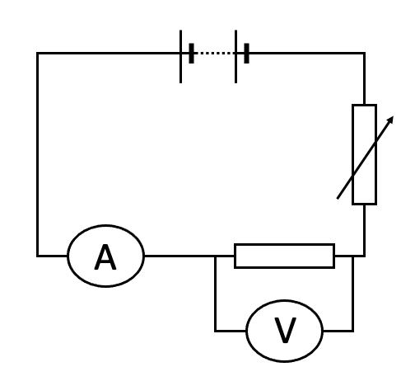
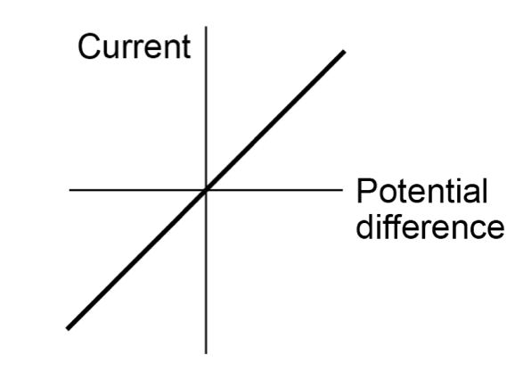
RP16
Investigating IV Characteristics
Investigating IV Characteristics of a Resistor
1
Set up equipment as shown in the diagram.
2
Record the current and voltage.
3
Adjust the variable resistor 4 more times recording the new current and voltage each time.
4
Swap the leads on the battery so that the reading on the ammeter and voltmeter is negative.
5
Record the current and voltage 5 times adjusting the variable resistor between each reading.
6
Plot a graph of current against potential difference.

Slide 18
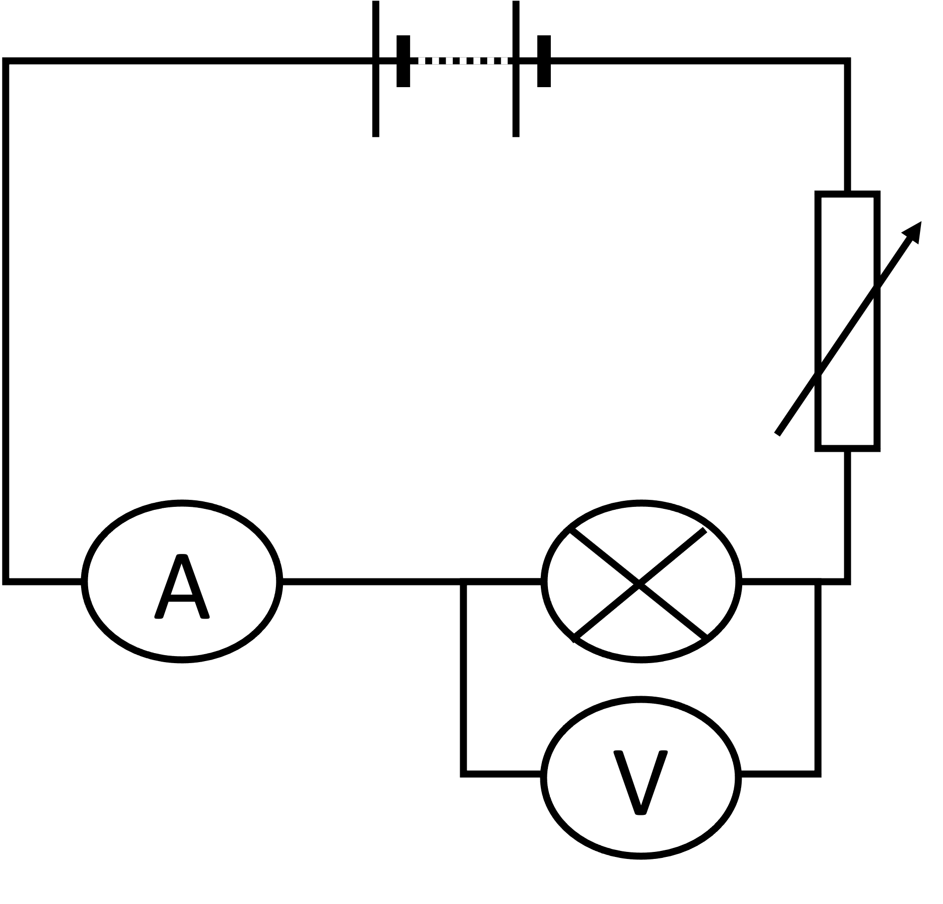
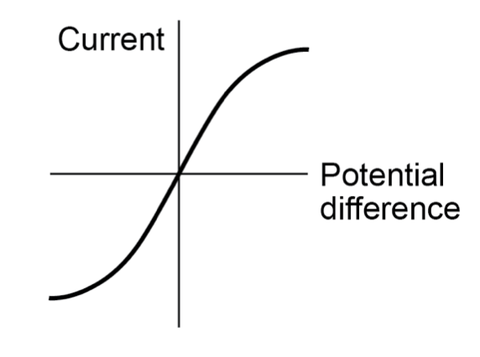
RP16
Investigating IV Characteristics
Investigating IV Characteristics of a Lamp
1
Set up equipment as shown in the diagram.
2
Record the current and voltage.
3
Adjust the variable resistor 4 more times recording the new current and voltage each time.
4
Swap the leads on the battery so that the reading on the ammeter and voltmeter is negative.
5
Record the current and voltage 5 times adjusting the variable resistor between each reading.
6
Plot a graph of current against potential difference.

Slide 19
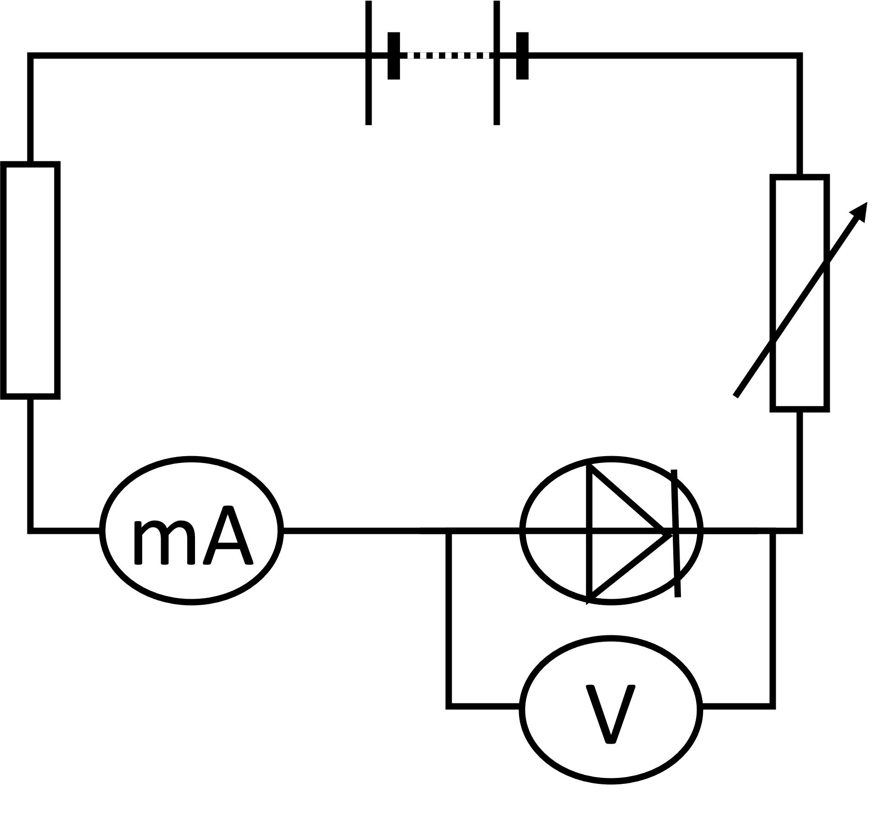
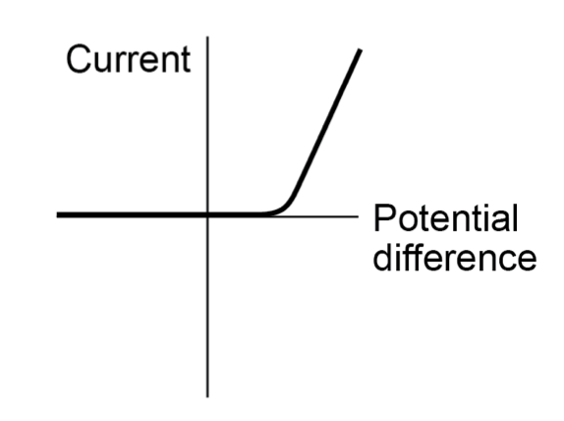
RP16
Investigating IV Characteristics
Investigating IV Characteristics of a Diode
1
Set up equipment as shown in the diagram with a battery no higher than 5V.
2
Record the current and voltage.
3
Adjust the variable resistor 4 more times recording the new current and voltage each time.
4
Swap the leads on the battery so that the reading on the ammeter and voltmeter is negative.
5
Record the current and voltage 5 times adjusting the variable resistor between each reading.
6
Plot a graph of current against potential difference.

Slide 20
RP16: Investigating IV Characteristics
Fold page here
What unit is current measured in?
What unit is potential difference measured in?
Which piece of equipment is used to measure current?
What piece of equipment is used to measure potential difference?
How should an ammeter be connected to determine the current through a component?
How should an voltameter be connected to determine the potential difference across a component?
What piece of equipment should you use to measure current when investigating the IV characteristics of a diode?
What should the potential difference of the power supply be when investigating IV characteristics of a diode?
How do you get negative current and voltage readings?
Why is a variable resistor used when investigating IV characteristics?
How many positive pairs of readings should you collect?
How many negative pairs of readings should you collect?
What do you do with your currents and voltages that have been recorded?
When plotting a graph of current against potential difference which goes on the X-axis?
When plotting a graph of current against potential difference which goes on the Y-axis?
How could you tell if an ammeter or voltameter have zero error.
When investigating IV characteristics what should be controlled?
How could temperature be controlled when investigating IV characteristics?
Amps (A)
Volts (V)
Ammeter
Voltmeter
In series
In parallel
Milliammeter
5V or less
Swap the leads connecting the power supply.
To change the resistance in the circuit so that more current and voltage pairs can be determined.
5
5
Plot a graph of current against potential difference
Potential Difference
Current
They would show a reading when not connected in a circuit.
Temperature
Turn the power supply off between readings to prevent components warming up.

Slide 21
RP16 Investigating IV Characteristics
Explain how to investigate the IV characteristics of a __________
You could be asked this question for different components. Some that have come up in the past include:
Resistor
Filament Lamp
Diode
To answer this question, you will need to do the following:
Draw a diagram of how to set up equipment.
Identify the readings you will collect.
Describe what you will do with results.
Be careful drawing your components. Draw the ammeter in series while a voltmeter should be connected in parallel.
Explain how to investigate the IV characteristics of a __________
Set up the equipment as shown in the diagram.
Record the current and voltage.
Adjust the variable resistor.
Record the new current and voltage.
Repeat this until you have 5 pairs of readings.
Swap the connections to the battery.
Repeat steps 3-4 until you have 5 negative pairs or readings.
Draw a graph of current against potential difference.
Learn and practice the model answer above.
Prepare and learn model answers to explain how you would investigate the IV characteristics of diodes and filament lamps.

