Slide 1
Biology Paper 1
Topics in the Paper:
B1 | Cell Structure
B2 | Cell Division
B3 | Organisation and the Digestive System
B4 | Organising Animals
B7 | Non-Communicable Disease
B8 | Photosynthesis
RP3 | Qualitative Reagents
RP4 | Enzymes
RP5 | Light Intensity
Biology Paper 1
Model Exam Question Booklet
Essential Content for the 2022 Higher Trilogy Science Exam
This booklet is split into 3 parts.
Part 1
The first part is a selection of short response questions and answers that are likely to come in your Biology exams this summer. Spend time learning the answers to these questions, for example you could produce flash cards. You should self quiz yourself on these questions regularly!
Part 2
Selection of extended response questions (4 to 6 marks) that are likely to be on your paper this year, either because they have not been assessed in the last couple of years, or because they come up most years in exams. Prepare and practice your responses to these questions.
Part 3
Required practical section. In this section you will find step by step guidance for each practical. This is followed by a page of short response questions and answers to learn for each of the practicals. There are also some extended response questions (4 to 6 marks) that are very likely to be on the exam paper this year.

Slide 2

B1: Cell Structure
Fold page here
What is a eukaryotic cell?
What is a prokaryotic cell?
What is a plasmid?
What type of cell is a bacterial cell?
How does the size of a prokaryotic cell compare to a eukaryotic cell?
What is the function of the nucleus?
What is the function of the cytoplasm?
What is the function of the cell membrane?
What is the function of the mitochondria?
Wat is the function of ribosomes?
What is the function of chloroplasts?
What is the permanent vacuoles function?
How is the cell wall strengthened?
What are the common parts of an animal cell?
What are the common parts of a plant cell?
What is the function of a sperm cell?
How is a sperm cell adapted?
What is the function of a nerve cell?
How is a nerve cell adapted?
What is the function of a muscle cell?
How is a muscle cell adapted?
What is the function of the root hair cells?
How is a root hair cell adapted?
What is the function of the xylem?
How are the xylem adapted for their function?
What are the function of phloem cells?
How are phloem cells adapted for their function?
What is the formula for magnification?
A plant or animal cell that has a cell membrane, cytoplasm and its genetic material enclosed in a nucleus.
A cell in which the genetic material is not enclosed in a nucleus. Its DNA is found as a loop in the cell and there may be one or more plasmids.
A small ring of DNA.
Prokaryotic cell.
Much smaller.
Control the cell.
Site of chemical reactions.
Controls what enters and leaves the cell.
Site of respiration.
Site of protein synthesis.
Site of photosynthesis.
Supports the cell and contains cell sap.
Cellulose.
Nucleus, cell membrane, cytoplasm, mitochondria and ribosomes.
Nucleus, cell membrane, cytoplasm, mitochondria, ribosomes, chloroplasts, cell wall and vacuole.
Carry father’s genetic information and fertilise the egg.
Streamlined shape, nucleus contains 1 set of chromosomes, lots of mitochondria for respiration, contains digestive enzymes.
Transmit electrical impulses around the body.
Long, and lots of dendrites to make connections with lots of other cells.
Contract and relax to bring about movement.
Lots of mitochondria for respiration.
Absorb mineral ions and water from soil.
Large surface area and lots of mitochondria for respiration.
Transport water around the plant.
Few cell structures and so they are dead for more space and supported by lignin.
Transport sugars around the plant.
Few cell structures and supported by companion cells.
Magnification = Size of Image /Size of Real Object

Slide 3
B2: Cell Division
Fold page here
What does the nucleus contain?
What are chromosomes made of?
What happens during the cell cycle?
How many stages are there are of the cell cycle?
What are the stages of the cell cycle?
What happens to a cell in stage 1 before it divides?
What happens to the nucleus during mitosis?
What happens in stage 3 of the cell cycle after mitosis?
Why is cell division by mitosis important?
What is a stem cell?
What are meristems?
What can plant stem cells be used for?
What are the advantages of embryonic stem cells?
What are the disadvantages of embryonic stem cells?
What are the advantages of adult stem cells?
What are the disadvantages of adult stem cells?
Why do some scientists have concerns about the use of stem cells?
What are the sources of adult stem cells?
Why might stem cells from embryos be more useful than adult stem cells?
What happens during the process of therapeutic cloning?
What are the advantages of therapeutic cloning?
What are the disadvantages of therapeutic cloning?
Why do most organisms have an even number of chromosomes in their body cells?
Chromosomes made of DNA.
DNA
The genetic material is doubled and then divided into two identical cells.
3
Growth, mitosis followed by cell division.
It needs to grow and increase the number of sub-cellular structures such as ribosomes and mitochondria. The DNA replicates to make two copies of each chromosome.
One set of chromosomes is pulled to each end of the cell and the nucleus divides.
The cytoplasm and cell membrane divide to make two identical cells.
Needed for growth and development of multicellular organisms.
An undifferentiated cell which is able to differentiate and divide to form lots of cells of the same type.
Plant stem cells that can differentiate into any type of plant cell throughout the life of the plant.
They can be used to make clones of plants quickly and economically
Can develop into most other types of cells, each cell divides every 30 minutes, low chance of rejection and painless.
Cause death to the embryo, unreliable and the embryos can’t give consent.
Permission can be given to collect stem cells and they are safe.
Risk of infection from operation, painful to donate stem cells and few types of cells.
Could cause cancer.
Bone marrow, umbilical cord, blood, skin.
Become more types of cells.
An embryo is produced with the same genes as the patient.
May cure diseases, produce replacement cells, treat diabetes and paralysis. Cells unlikely to be rejected, cells and tissues of any type can be made, many cells are produced and reduces waiting time for transplants.
Potential life is killed, shortage of egg donors, may transfer viral infection, poor success rate.
Chromosomes come in pairs.

Slide 4
B3: Digestion
Fold page here
What is the function of the digestive system?
What are enzymes?
How do enzymes work?
What effect does temperature have on enzyme activity?
How are enzymes are denatured by temperature?
Why do enzymes have an optimum pH?
Where is amylase made in the body?
What is the function of amylase?
Where is protease made in the body?
What is the function of protease?
Where is lipase made in the body?
What is the function of lipase?
What is the function of digestive enzymes?
What are the products of digestion used for?
Where is starch digested in the body?
Where is protein digested in the body?
Where are fats digested in the body?
Why is starch not digested in the stomach?
How can the mouth break down starchy foods?
Where is bile made?
Where is bile stored?
What is the function of bile?
An organ system in which several organs work together to digest and absorb food.
Biological catalysts with a specific active site that speed up reactions.
The substrate fits into the active site of the enzyme and the enzyme and substrate binds together. The reaction happens quickly, and the products are released.
At temperature increase the rate of reaction increases. At the optimum temperature, the reaction works as fast as possible. After the optimum temperature, the enzyme begins to be denatured and so the enzyme stops working.
The high temperature causes the protein chains to unravel changing the shape of the active site.
The forces holding the protein chains in position are affected by pH. A change in pH can change the shape of the active site.
Salivary glands, small intestine and pancreas.
Break down starch into glucose.
Stomach, small intestine and pancreas.
Break down proteins into amino acids.
Pancreas and small intestine.
Break down lipids into fatty acids and glycerol.
Convert food into small soluble molecules that can be absorbed into the bloodstream.
Build new carbohydrates, lipids and proteins. Some glucose is used in respiration.
Mouth and small intestine.
Stomach and small intestine.
Small intestine
The stomach doesn’t produce amylase and the conditions in the stomach are too acidic for the amylase to work.
The teeth break down the food and the saliva contains amylase.
Liver
Gall Bladder
It is alkaline to neutralise hydrochloric acid from the stomach. It also emulsifies fat to form small droplets which increases the surface area. This increases the breakdown of fat by lipase.

Slide 5
B4: Organisation: Heart
and Blood
Fold page here
What is the heart?
Why is the heart known as a double pump?
What is the route of a blood cell through the heart?
What is the function of the right ventricle?
What is the function of the left ventricle?
What is the function of the aorta?
What is the function of the vena cava?
What is the function of the pulmonary artery?
What is the function of the pulmonary vein?
How is resting heart rate controlled?
Where is the natural pacemaker found?
What are artificial pacemakers?
What is the function of the arteries?
How are the arteries adapted for the function?
What is the function of capillaries?
How are capillaries adapted for their function?
What is the function of veins?
How are the veins adapted for their function?
How can we calculate rate of blood flow?
What is blood?
What are the components of blood?
What is the function of plasma?
What is transported in blood plasma?
What is the function of red blood cells?
What is the function of white blood cells?
How do WBC defend from infection?
What is the function of platelets?
What are platelets?
An organ that pumps blood around the body in a double circulatory pump.
Blood enters the heart twice for one circuit around the body.
Body → Vena Cava → Right Atrium → Right Ventricle → Pulmonary Artery → Lungs → Pulmonary Vein → Left Atrium → Left Ventricle → Aorta → Body
Pumps blood to the lungs where gas exchange takes place.
Pumps blood around the rest of the body.
Transport oxygenated blood under high pressure away from the left ventricle of the heart.
Return deoxygenated blood from the body to the right atrium of the heart.
Transport deoxygenated blood from the heart to the lungs.
Transport oxygenated blood from the lungs to the heart.
Group of cells known as a pacemaker.
Right atrium.
Electrical devices used to correct irregularities in the heart rate.
Transport oxygenated blood under high pressure from the heart to the body.
Narrow lumen, thick elastic walls to withstand pressure.
Transport blood to cells.
Narrow so that blood cells pass through them one by one and have thin walls for a short diffusion pathway.
Transport deoxygenated blood under high pressure from the body to the heart.
Thin walls and large lumen due to low pressure. They have valves to prevent backflow.
Rate of Blood Flow = Volume of Blood / Number of Minutes
A tissue made up of plasma in which red blood cells, white blood cells and platelets are suspended.
Plasma, red blood cells, white blood cells and platelets.
Transport blood cells and different substances such as hormones around the body.
Carbon dioxide, urea, hormones, products of digestion.
Transport oxygen around the body.
Defend the body from infection.
Phagocytosis, produce antibodies, produce antitoxins.
Clot blood.
Small fragments of cells without a nucleus.

Slide 6
B7: Non-Communicable
Disease
Fold page here
What is a non-communicable disease?
What is a casual mechanism?
What are the risk factors of cardiovascular disease?
What are the risk factors of type 2 diabetes?
What are the risk factors of lung cancer?
What risk factors can affect an unborn baby?
What is meant by obesity?
What diseases are linked to obesity?
What are risk factors of cancer?
What is cancer?
What are benign tumours?
What are malignant tumours?
How does cancer travel around the body?
What is the difference between a malignant and benign tumour?
Why can smoking increase the risk of heart disease?
Why can smoking increase the risk of lung cancer?
Why can smoking increase the risk of emphysema?
Why can smoking increase the risk of lung infections?
A non-infectious disease that can’t be caught from another person.
Something that explains how one factor influences another
Poor diet, smoking and lack of exercise
Obesity
Smoking
Smoking and alcohol
Being overweight with a BMI over 25
Arthritis, diabetes, high blood pressure, strokes
Carcinogens and ionising radiation
A non-communicable disease that is caused by a change in cells that leads to uncontrolled growth and division.
Growths of abnormal cells which are contained within one area by a membrane. They do not invade other parts of the body.
Growths of abnormal cells which invade neighbouring tissues and spread to other parts of the body in the blood where they form secondary tumours.
Cells break off and travel in the blood.
Benign tumours do not invade, malignant do.
It raises blood pressure, increases cholesterol and leads to thickening of the artery walls.
The chemicals in smoke can cause mutations leading to uncontrolled growth of cells.
Smoking damages the alveoli causing the surface area to decrease. This causes shortness of breath.
Chemicals in the smoke damage the cilia which causes mucus production to increase, this causes shortness of breath and increased risk of infection.

Slide 7
B8: Photosynthesis
Fold page here
What is the word equation for photosynthesis?
What is the formula for carbon dioxide?
What is the formula for water?
What is the formula for oxygen?
What is the formula for glucose?
What is the balanced symbol equation for photosynthesis?
What is photosynthesis?
What factors affect the rate of photosynthesis?
How does temperature affect photosynthesis?
How does light intensity affect photosynthesis?
How does carbon dioxide concentration affect photosynthesis?
How does the amount of chlorophyll affect photosynthesis?
How can you measure the rate of photosynthesis?
How can you test if a plant for starch?
What cell part is needed for photosynthesis to take place?
Carbon Dioxide + Water → Glucose + Oxygen
CO₂
H₂O
O₂
C₆H₁₂O₆
6CO₂ + 6H₂O → C₆H₁₂O₆ + 6O₂
It is an endothermic reaction in which energy is transferred from the environment to the chloroplasts by light.
Temperature, Light Intensity, Carbon Dioxide Concentration, Amount of Chlorophyll
As temperature rises the rate of photosynthesis increases, when temperature becomes too high enzymes are denatured and so rate of photosynthesis decreases until it stops completely.
The brighter the light the greater the rate of photosynthesis.
The greater the concentration of carbon dioxide the greater the rate of photosynthesis.
The more chlorophyll the greater the rate of photosynthesis.
Place the plant underwater and measure the volume of oxygen made or count the number of bubbles in a given time. The more gas made, the faster the rate of photosynthesis.
Boil in ethanol to destroy waxy cuticle and remove the colour. Then add iodine to the leaf. If the iodine turns blue it contains starch.
Chloroplast

Slide 8
Topic | B1 Cell Structure and Transport
Qu | Explain how a ___________ cell is adapted for its function.
Info | You could be asked this question for any of the following specialised cells: Sperm Cell Nerve Cell Muscle Cell Red Blood Cell Root Hair Cell Xylem Phloem To answer this question you will need to do the following: Identify the function (job) of the specialised cell. Describe an adaptation that the cell has. Explain how this adaptation helps the cell complete its function. Continue to describe another adaptation the cell has and explain how this helps complete its function until you can think of no more adaptations.
Top Tip | If you are explaining why a cell has lots of mitochondria use the following phrase: “The cell has lots of mitochondria, for respiration, to release more energy”
Model Answer | Explain how a sperm cell is adapted for its function. The function of the sperm cell is to carry the father’s genetic information and fertilise the egg. Adaptations the sperm cell have include that it is streamlined to reduce the cells energy requirements to travel to the egg. Another adaptation is that the nucleus contains 1 set of chromosomes, this preserves the chromosome number when the egg is fertilised. A third adaptation is that the sperm cell has an acrosome that contains digestive enzymes that enables the sperm cell to penetrate the egg. Finally, the sperm cell has lots of mitochondria, for respiration, to release more energy for the cell.
Practice | Learn and practice the model answer above. Prepare and learn model answers to explain how the following cells are adapted for their function: nerve cell, muscle cell, red blood cell, root hair cell, xylem and phloem

Slide 9
Topic | B2 Cell Division
Qu | Stem cells can be used to treat diseases such as ________. Evaluate the use of adult and embryonic stem cells to treat ___________.
Info | You could be asked this question for disease that can be treated using stem cells including: Paralysis Diabetes Cancer To answer this question you will need to do the following: Describe the advantages of adult stem cells Describe the disadvantages of adult stem cells Describe the advantages of embryonic stem cells Describe the disadvantages of embryonic stem cells State a conclusion Give at least 1 statement to support your conclusion
Top Tip | If they give you information in the exam question interpret it and discuss it, but make sure that you use your own knowledge as well. This is important as you won't get many marks (if any) by just repeating what they have given you in the question.
Model Answer | Evaluate the use of stem cells from a patient’s own bone marrow instead of stem cells from an embryo. Advantages of stem cells from a patients own bone marrow include that the patient can give consent for the procedure to take place, which removes any ethical issues. As well as this the procedure is well tested and relatively safe. However, disadvantages of using stem cells from bone marrow include that the procedure is painful and can cause infection. The advantages of using stem cells from an embryo include that it is a painless procedure that can treat many diseases. However, disadvantages of using stem cells from embryos include it is an unreliable procedure that causes death to the embryo that poses ethical issues as the embryo can’t give consent. In conclusion I think that __________ because _____
Practice | Construct your own conclusion for this model answer. Learn and practice the model answer above.

Slide 10
Topic | B3 Digestion
Qu | Describe how _______ is digested.
Info | You could be asked this question to test for: Protein Starch Fat A combination of some/all of them To answer this question you will need to do the following: Describe mechanical digestion in the mouth. Identify the enzyme that helps digest it. Identify where in the body this enzyme digests the molecule. Identify what the food substance is broken down into.
Top Tip | Be careful with your enzyme names and sites of digestion. It is easy to mix up where the enzyme is made and where the enzyme acts. For examples enzymes made by the pancreas digest food in the small intestine.
Model Answer | Explain how protein is digested. The protein is firstly broken down mechanically into smaller pieces by chewing in the mouth before the food is swallowed. Protease enzymes break down the protein in the stomach and small intestine. The protein is broken down into amino acids.
Practice | Learn and practice the model answer above. Prepare and learn model answers to explain how starch, fat and a combination of all three are broken down.

Slide 11
Topic | B3 Digestion
Qu | Explain how bile helps the digestion of fats. Describe the roles of the liver and the pancreas in digestion. Explain the ‘lock and key theory’ of enzyme action.
Info | At least one of these questions is likely to come up. The examiner is going to be looking for a clear answer written in a logical sequence.
Top Tip | Be careful that you use key words/phrases accurately (these are in bold in your model answers below).
Model Answer | Explain how bile helps the digestion of fats. Bile is alkaline and so neutralises the digestive juices in the small intestine. It also emulsifies fats which gives them a larger surface area. This means that enzymes work more efficiently.
Model Answer | Describe the roles of the liver and the pancreas in digestion. The liver produces bile which is alkaline and neutralises digestive juices. It also emulsifies fats which increases its surface area. The pancreas produces digestive enzymes such as protease, lipase and amylase.
Model Answer | Explain the ‘lock and key theory’ of enzyme action . The enzyme binds to the substrate because they are complimentary shapes. The substrate is broken down and the products are released. The enzyme remains unchanged.
Practice | Learn and practice the model answers above.

Slide 12
Topic | B4 Organising Animals
Qu | Explain the function and structure of red blood cells. Describe how the composition of blood changes as it flows from the lungs to the body. Describe the composition of blood.
Info | At least one of these questions is likely to come up. The examiner is going to be looking for a clear answer written in a logical sequence.
Top Tip | Be careful that you use key words/phrases accurately (these are in bold in your model answers below).
Model Answer | Explain the function and structure of red blood cells. Red blood cells are a biconcave disc shape and contain a pigment called haemoglobin. Oxygen combines with the haemoglobin to form oxyhaemoglobin so that the red blood cells can transport oxygen from the lungs around the body. So that there is more space for this haemoglobin the cell does not have a nucleus.
Model Answer | Describe how the composition of blood changes as it flows from the lungs to the body. As blood flows from the lungs the amount of oxygen carried by the red blood cells decreases while the amount of carbon dioxide dissolved in the plasma increases.
Model Answer | Describe the composition of blood. Blood is made up of four components. It contains red blood cells for transporting oxygen, white blood cells which help defend the body from infection, platelets for blood clotting and plasma in which substances such as carbon dioxide and urea dissolve into.
Practice | Learn and practice the model answers above.

Slide 13
Topic | B4 Organising Animals
Qu | Describe the function of ______ and explain how it is adapted for its function.
Info | You could be asked this question for each of the different blood vessels: Arteries Capillaries Veins To answer this question, you will need to do the following: Identify what the blood vessel does. Identify an adaptation that the blood vessel has. Explain how this adaptation helps the blood vessel perform its function. Repeat steps 2 and 3 for as many adaptations that you can think of.
Top Tip | When answering this question some different adaptations to consider include the thickness of the blood vessel walls, the size of the lumen and if the blood vessel has valves or not.
Model Answer | Describe the function of arteries and explain how it is adapted for its function. The function of arteries is to pump oxygenated blood away from the heart to the rest of the body under high pressure. To do this the blood vessel has some adaptations. Firstly, it has thick elastic walls, this is to withstand the high pressure. They also have a narrow lumen to maintain this high pressure.
Practice | Learn and practice the model answer above. Prepare and learn model answers to describe the structure and function of veins and arteries.

Slide 14
Topic | B4 Organising Animals
Qu | Compare the structure of arteries and veins. Describe what coronary heart disease is and the problems it causes. Describe and explain some of the treatments for coronary heart disease.
Info | At least one of these questions is likely to come up. The examiner is going to be looking for a clear answer written in a logical sequence.
Top Tip | Be careful that you use key words/phrases accurately (these are in bold in your model answers below).
Model Answer | Compare the structure of arteries and veins. Arteries do not have valves, while veins do. The arteries also have a thicker wall when compared to the vein. Finally, the artery has a narrower lumen when compared to veins.
Model Answer | Describe what coronary heart disease is and the problems it causes Coronary heart disease is when layers of fat build up inside the coronary arteries. This reduces the flow of blood through the arteries and can result in a lack of oxygen for the heart muscle.
Model Answer | Describe and explain some of the treatments for coronary heart disease. Stents can be used to keep the coronary artery open and statins can be used to lower cholesterol levels which slows down the deposit of fatty material. In the event that the heart fails the patient may be able to have a heart transplant.
Practice | Learn and practice the model answers above.

Slide 15
Topic | B7 Non-Communicable Disease
Qu | Explain how a foetus may be affected if a mother smokes during pregnancy. Compare malignant and benign tumours. Describe how smoking can affect health.
Info | At least one of these questions is likely to come up. The examiner is going to be looking for a clear answer written in a logical sequence.
Top Tip | Be careful that you use key words/phrases accurately (these are in bold in your model answers below).
Model Answer | Explain how a foetus may be affected if a mother smokes during pregnancy. The cigarette smoke will contain carbon monoxide which occupies the mothers red blood cells and so reduces the amount of oxygen that the mothers blood contains. This means that the foetus receives less oxygen which reduces the rate of respiration in the foetus which causes the birth mass of the baby to be less.
Model Answer | Compare malignant and benign tumours. Both benign tumours and malignant tumours are growth of abnormal cells. However, benign tumours do not invade other areas of the body and are enclosed in a membrane, while malignant tumours do invade other areas of the body. Malignant tumours do this by some cells breaking off and travelling through the blood to form a secondary tumour elsewhere.
Model Answer | Describe how smoking can affect health. Firstly smoking raises blood pressure, increases cholesterol and leads to thickening of the artery walls. This leads to increased risk of heart disease. The chemicals in smoke can also cause mutations leading to uncontrolled growth of cells which can cause cancer. Smoking can also damage the alveoli causing the surface area to decrease. This causes shortness of breath and leads to a disease called emphysema. Finally the chemicals in the smoke damage the cilia which causes mucus production to increase, this causes shortness of breath and causes the person to be at an increased risk of infection.
Practice | Learn and practice the model answers above.

Slide 16
Topic | B8 Photosynthesis
Qu | Explain how _________ affects the rate of photosynthesis.
Info | You could be asked how the following factors affect the rate of photosynthesis: Temperature Light Intensity Carbon Dioxide Concentration Amount of Chlorophyll To answer this question you will need to do the following: Describe what happens as the factor increases. Explain how increasing this factor affects the rate of photosynthesis.
Top Tip | As each factor increases the rate of photosynthesis does not continue to just increase. Explain why.
Model Answer | Explain how temperature affects the rate of photosynthesis. As temperature increases the rate of photosynthesis increases. This is because the reactant particles and enzymes collide more. When temperature continues to increase further the rate of photosynthesis decreases. This is because at the high temperature the enzyme begins to be denatured.
Practice | Learn and practice the model answer above. Prepare and learn model answers to explain the effect of light intensity, carbon dioxide concentration and amount of chlorophyll on the rate of photosynthesis.

Slide 17
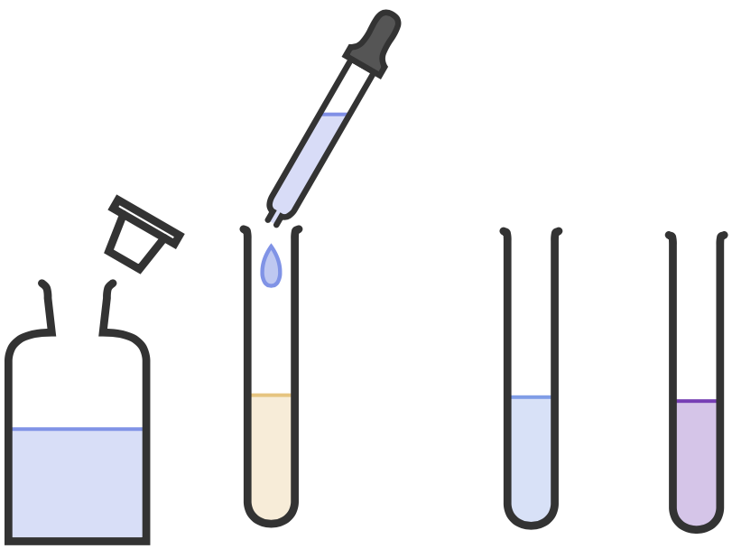

RP3
Food Tests Required Practical
Testing for Proteins
Preparation
If the food is already in solution (such as milk) no further preparation is needed. If the food is solid it needs to be ground up using a pestle and mortar and added to water to make a solution.
Add Biuret Reagent to the food sample.
If there is no protein the
sample remains blue.
Biuret
Reagent
Food
Sample
If there is protein the
sample turns purple.
Practical Video

Slide 18
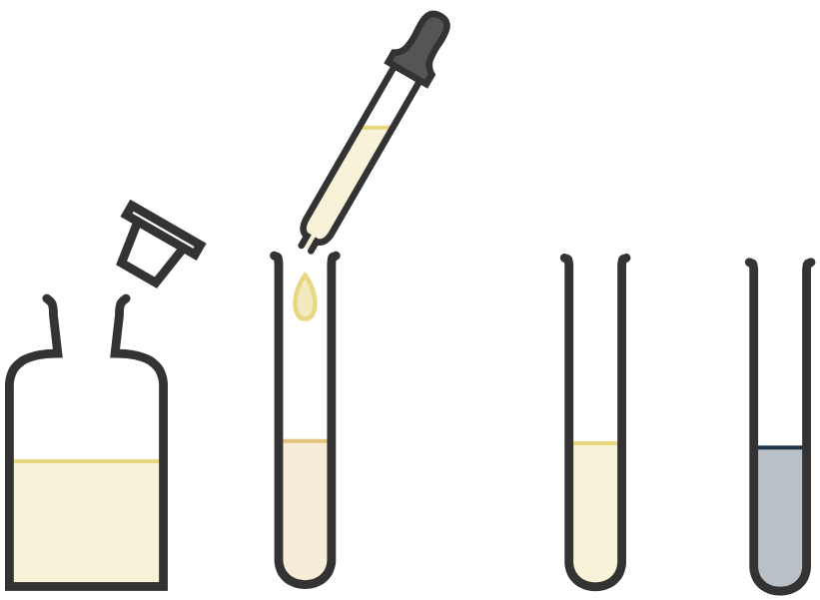
RP3
Food Tests Required Practical
Testing for Starch
Preparation
If the food is already in solution (such as milk) no further preparation is needed. If the food is solid it needs to be ground up using a pestle and mortar and added to water to make a solution.
Add iodine to the food sample.
If there is no starch the
sample remains yellow.
Iodine
Solution
Food
Sample
If there is starch the
sample turns blue/black.
Practical Video

Slide 19
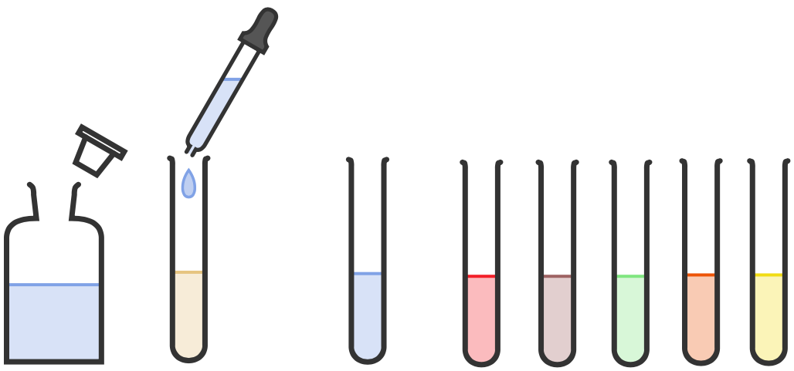
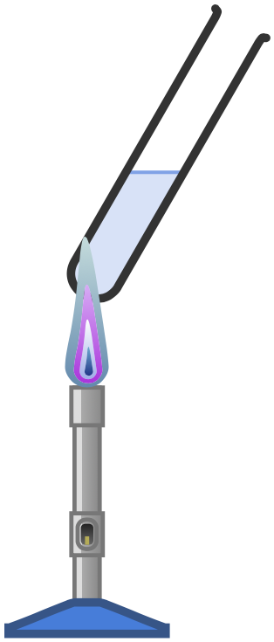
RP3
Food Tests Required Practical
Testing for Glucose
Preparation
If the food is already in solution (such as milk) no further preparation is needed. If the food is solid it needs to be ground up using a pestle and mortar and added to water to make a solution.
If there is no glucose the
sample remains blue.
Add Benedicts Reagent to the food sample.
HEAT
If there is glucose the sample turns red, orange, yellow, brown or green.
Benedicts Reagent
Food
Sample
Practical Video

Slide 20
Required Practical 3: Testing Foods
Fold page here
How do you prepare a solid food sample to test for nutrients?
What reagent is used to test for proteins?
What colour change indicates a positive result for protein?
How do you test for protein?
What reagent is used to test for starch?
What colour change indicates a positive result for starch?
How do you test for starch?
What reagent is used to test for glucose?
What colour change indicates a positive result for glucose?
How do you test for glucose?
What are examples of carbohydrates?
Which reagents would you use to test for carbohydrates?
Grind up using a pestle and mortar and then add water to form a solution.
Biuret solution
Colour change to purple.
Add biuret solution and look for a colour change to purple.
Iodine
Colour changes to blue/black
Add iodine and look for a colour change to blue/black.
Benedicts
A colour change to red/green/orange/yellow
Add Benedicts, heat and look for colour change to red/green/orange/yellow.
Starch and glucose
Amylase for starch and Benedicts for glucose

Slide 21
Topic | Required Practical 3: Testing Foods
Qu | Explain how to test a substance for the presence of _________
Info | You could be asked this question to test for: Starch Glucose Proteins A combination of some/all of them To answer this question you will need to do the following: Identify the chemical you would use to test for the food substance. Describe what you would do. Identify the positive result Repeat steps 1-3 for another food substance if the exam question is asking about more than one substance in the food.
Top Tip | Be careful with your colour changes. Marks will be awarded for identifying the colour that shows a positive result, not for the start colour. If you don’t know the start colour, don’t include it as it could lose you marks.
Model Answer | Explain how to test a substance for the presence of glucose. Add Benedict's solution to your sample of food in solution and heat it. A positive test for glucose would be the solution turning red. If the solution does not change colour no glucose is present.
Practice | Learn and practice the model answer above. Prepare and learn model answers to explain how to test for starch, lipids and proteins. Prepare and learn a model answer to explain how to test 1 food for the presence of glucose, starch and proteins

Slide 22
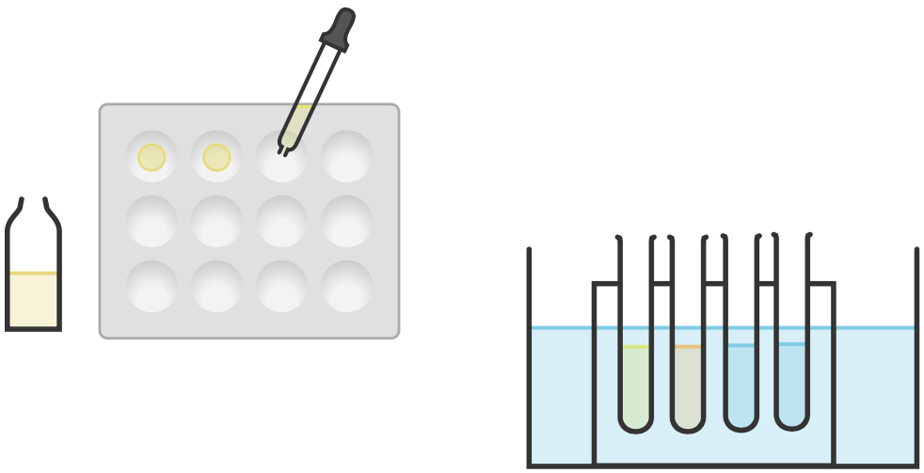
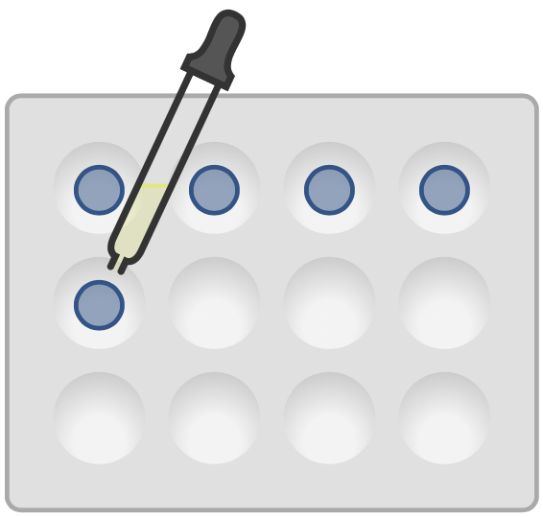

RP4
Investigating Enzymes
1.
Add a few drops of iodine solution to each dimple in a spotting tile.
Water bath at set temperature
2.
Add a fixed volume of starch, amylase and pH buffer solutions to a water bath at a set temperature. Leave for 5 minutes.
Starch
Solution
pH Buffer Solutions
3.
Mix the starch solution and amylase solution together.
Amylase
Solution
4.
Every 30 seconds add a few drops to the spotting tile. Repeat until the iodine does not turn blue/black.
Practical Video
5.
Repeat for different pH’s or different temperatures.

Slide 23
RP4: Investigating Enzymes
Fold page here
What indicator would you use to test for the presence of starch?
What would be a positive test result for starch?
What would be a negative test result for starch?
What enzyme breaks down starch?
If amylase were added to a starch solution, what would you expect to happen to the starch?
What piece of equipment would you use to measure temperature?
What piece of equipment would you use to measure time?
What piece of equipment would you use to keep your solutions at a certain temperature?
Around what temperature would you expect amylase to work best and why?
Around what pH does amylase work best?
How frequently should you test your mixture for the presence of starch?
At high temperatures why would you expect for no starch to be broken down?
At low and high pH’s why would you expect for no starch to be broken down?
Why should you leave the solutions in the water bath for at least 5 minutes before testing?
Why would you expect it to take a longer for starch to disappear at low temperatures?
How could you use this experiment to determine the temperature or pH amylase works best?
Iodine
A blue/black colour change.
No colour change.
Amylase
It should be broken down.
Thermometer
Stopwatch
Water bath
37°C which is the temperature of the human body.
7
30 seconds
The enzyme would have been denatured.
The enzyme would have been denatured.
To allow the solutions time to get to the same temperature.
Molecules have low kinetic energy and so fewer collisions between starch and amylase.
Look for the quickest time that iodine stopped turning blue/black.

Slide 24
Topic | Required Practical 4: Investigating Enzymes
Qu | Explain the results obtained when investigating enzymes.
Info | You could be given data for testing enzymes at different temperatures or pH’s and be asked to explain and interpret it. To answer this question you will need to do the following: Identify the lowest value and explain the result. Describe and explain the overall trend to the point enzyme activity is at its greatest. Explain why after this point enzyme activity starts to decrease.
Top Tip | When you are describing a trend in data make sure you identify all points in which the trend changes. Refer to the data as much as you can.
Model Answer | Describe and explain the results below when amylase was added to starch at different temperatures. At 5°C the starch was not broken down. This is because at this low temperature the molecules have low kinetic energy and so there have been fewer collisions. As temperature continues to increase, enzyme activity increases also and peaks at 35°C when it took 2 mins for the starch to be broken down. As temperature continues to increase enzyme activity falls again. This is because at warmer temperatures the enzyme is denatured. At 80°C the starch has not been broken down because the enzyme has been completely denatured.
Practice | Construct your own answer in which you interpret and explain data of enzyme activity using the data below. | Construct your own answer in which you interpret and explain data of enzyme activity using the data below.
Temp (°C) | Time taken until iodine solution remains yellow (min)
5 | Did not turn yellow
20 | 5
35 | 2
50 | 7
65 | 14
80 | Did not turn yellow
Temp (°C) | Time taken until iodine solution remains yellow (min)
0 | Did not turn yellow
20 | 4
40 | 2
60 | 8
80 | Did not turn yellow
pH | Time taken until iodine solution remains yellow (min)
5 | Did not turn yellow
5 | 3
7 | 1
9 | 9
11 | Did not turn yellow

Slide 25
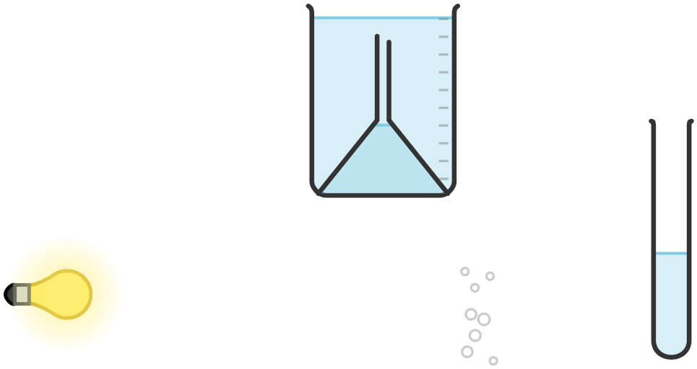
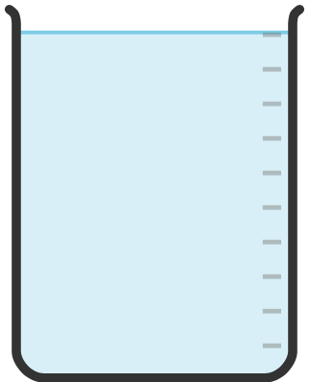


1.
Set up equipment as shown in the diagram with the pondweed in a beaker of water.
2.
Place the beaker 10cm away from the light source.
3.
Turn the light on and leave the pondweed for 5 minutes.
4.
Count the number of bubbles produced in a fixed period of time or measure how much gas is collected in a fixed period of time.
5.
Repeat to identify outliers and calculate averages.
6.
Repeat for different distances/temperatures.
RP5
Investigating Photosynthesis
Bubbles
Lamp
Pondweed
Practical Video
Ruler
Beaker

Slide 26
RP5: Photosynthesis Practical
Fold page here
When investigating the rate of photosynthesis what are the possible variables (one that will be changed, the others that will need to be controlled)?
Why do you leave the pondweed 5 minutes after the lamp has been turned on before counting any bubbles?
What piece of equipment would you use to change the distance of the lamp?
What would you use as a light source?
Why should you use an LED bulb when investigating the rate of photosynthesis?
What piece of equipment would you use to measure time?
Why might sodium hydrogen carbonate be added to the water?
Why are bubbles produced by the pondweed during the photosynthesis experiment?
What is the dependent variable when investigating photosynthesis?
Why is it important to use a thermometer when investigating the rate of photosynthesis?
How can we change the light intensity when investigating how light intensity affects the rate of photosynthesis?
How can the temperature be controlled in the experiment?
Why is it better to count the number of bubbles in every minute for 3 minutes rather than just count the bubbles for 3 minutes?
What two measurements need to be taken when investigating the rate of photosynthesis?
An alternative method is to put discs of pondweed/seaweed in a beaker and measure the time to rise to the surface, why would the discs rise to the surface?
Light intensity, temperature, carbon dioxide concentration, type of plant, surface are a of leaf, colour of plant, pH.
Gives the pondweed time to acclimatise.
Ruler
Lamp with an LED bulb.
It does not heat up and raise the temperature of the water.
Stopwatch
To ensure that there is an excess of carbon dioxide and that this does not become a limiting factor.
Number of bubbles produced in a given time.
Oxygen is a product of photosynthesis and so when the pondweed photosynthesises it makes bubbles of the gas that we can count.
It is used to measure the temperature, to check the temperature isn’t changing. This is important as temperature needs to be controlled.
Change the distance the lamp is from the plant.
Add the pondweed sample to a beaker of water, this helps maintain the temperature.
You can see outliers and so improves reliability.
The number of bubbles produced, in a certain time.
They have made oxygen, which causes them to float to the surface.

Slide 27
Topic | Required Practical 5: Light Intensity and Photosynthesis
Qu | Construct a method to investigate the effect of light intensity on the rate of photosynthesis.
Info | You could be asked this question to investigate the effect of light intensity on the rate of photosynthesis for lots of different plants. As you will be collecting gases the plants will all be plants that can survive and photosynthesise under water. To answer this question, you will need to do the following: Construct a clear method. Identify what you will measure. Identify control variables.
Top Tip | To change light intensity, you will change the distance the light is from the test plant. Make sure you include 5 different distances with regular intervals between them.
Model Answer | Construct a method to investigate the effect of light intensity on the rate of photosynthesis. Add a piece of pondweed to a boiling tube filled with water. Place this 10cm away from a light source and turn the light on. Weight 5 minutes for the pondweed to acclimate. Count the number of bubbles produced in 1 minute. Repeat step 4 twice more to identify outliers and calculate an average. Repeat steps 1-5 at 20cm, 30cm, 40cm and 50cm. Control variables include the colour of light and the type and size of pondweed used.
Practice | Learn and practice the model answer above. Prepare and learn model answers to investigate the effect of temperature and light colour on the rate of photosynthesis.

