Slide 1
Biology Paper 1
Topics in the Paper:
B1 | Cell Structure
B2 | Cell Division
B3 | Organisation and the Digestive System
B4 | Organising Animals
B5 | Communicable Disease
B6 | Preventing and Treating Disease
B7 | Non-Communicable Disease
B8 | Photosynthesis
RP1 | Using a Light Microscope
RP3 | Qualitative Reagents
RP5 | Light Intensity
Biology Paper 1
Model Exam Question Booklet
Essential Content for the 2022 Foundation Trilogy Science Exam
This booklet is split into 3 parts.
Part 1
The first part is a selection of short response questions and answers that are likely to come in your Biology exams this summer. Spend time learning the answers to these questions, for example you could produce flash cards. You should self quiz yourself on these questions regularly!
Part 2
Selection of extended response questions (4 to 6 marks) that are likely to be on your paper this year, either because they have not been assessed in the last couple of years, or because they come up most years in exams. Prepare and practice your responses to these questions.
Part 3
Required practical section. In this section you will find step by step guidance for each practical. This is followed by a page of short response questions and answers to learn for each of the practicals. There are also some extended response questions (4 to 6 marks) that are very likely to be on the exam paper this year.

Slide 2

B1: Cell Structure
Fold page here
What is a eukaryotic cell?
What is a prokaryotic cell?
What is a plasmid?
What type of cell is a bacterial cell?
How does the size of a prokaryotic cell compare to a eukaryotic cell?
What is the function of the nucleus?
What is the function of the cytoplasm?
What is the function of the cell membrane?
What is the function of the mitochondria?
Wat is the function of ribosomes?
What is the function of chloroplasts?
What is the permanent vacuoles function?
How is the cell wall strengthened?
What are the common parts of an animal cell?
What are the common parts of a plant cell?
What is the function of a sperm cell?
How is a sperm cell adapted?
What is the function of a nerve cell?
How is a nerve cell adapted?
What is the function of a muscle cell?
How is a muscle cell adapted?
What is the function of the root hair cells?
How is a root hair cell adapted?
What is the function of the xylem?
How are the xylem adapted for their function?
What are the function of phloem cells?
How are phloem cells adapted for their function?
What are the advantages of electron microscopes?
What have been the benefits of electron microscopes?
What is the formula for magnification?
A plant or animal cell that has a cell membrane, cytoplasm and its genetic material enclosed in a nucleus.
A cell in which the genetic material is not enclosed in a nucleus. Its DNA is found as a loop in the cell and there may be one or more plasmids.
A small ring of DNA.
Prokaryotic cell.
Much smaller.
Control the cell.
Site of chemical reactions.
Controls what enters and leaves the cell.
Site of respiration.
Site of protein synthesis.
Site of photosynthesis.
Supports the cell and contains cell sap.
Cellulose.
Nucleus, cell membrane, cytoplasm, mitochondria and ribosomes.
Nucleus, cell membrane, cytoplasm, mitochondria, ribosomes, chloroplasts, cell wall and vacuole.
Carry father’s genetic information and fertilise the egg.
Streamlined shape, nucleus contains 1 set of chromosomes, lots of mitochondria for respiration, contains digestive enzymes.
Transmit electrical impulses around the body.
Long, and lots of dendrites to make connections with lots of other cells.
Contract and relax to bring about movement.
Lots of mitochondria for respiration.
Absorb mineral ions and water from soil.
Large surface area and lots of mitochondria for respiration.
Transport water around the plant.
Few cell structures and so they are dead for more space and supported by lignin.
Transport sugars around the plant.
Few cell structures and supported by companion cells.
Higher magnification and higher resolution.
Can be used to examine a cell in much finer detail and has led to a better understanding of sub cellular structures.
Magnification = Size of Image /Size of Real Object

Slide 3
B2: Cell Division
Fold page here
What does the nucleus contain?
What are chromosomes made of?
What happens during the cell cycle?
How many stages are there are of the cell cycle?
What are the stages of the cell cycle?
What happens to a cell in stage 1 before it divides?
What happens to the nucleus during mitosis?
What happens in stage 3 of the cell cycle after mitosis?
Why is cell division by mitosis important?
What is a stem cell?
What are meristems?
What can plant stem cells be used for?
What are the advantages of embryonic stem cells?
What are the disadvantages of embryonic stem cells?
What are the advantages of adult stem cells?
What are the disadvantages of adult stem cells?
Why do some scientists have concerns about the use of stem cells?
What are the sources of adult stem cells?
Why might stem cells from embryos be more useful than adult stem cells?
What happens during the process of therapeutic cloning?
What are the advantages of therapeutic cloning?
What are the disadvantages of therapeutic cloning?
Why do most organisms have an even number of chromosomes in their body cells?
Chromosomes made of DNA.
DNA
The genetic material is doubled and then divided into two identical cells.
3
Growth, mitosis followed by cell division.
It needs to grow and increase the number of sub-cellular structures such as ribosomes and mitochondria. The DNA replicates to make two copies of each chromosome.
One set of chromosomes is pulled to each end of the cell and the nucleus divides.
The cytoplasm and cell membrane divide to make two identical cells.
Needed for growth and development of multicellular organisms.
An undifferentiated cell which is able to differentiate and divide to form lots of cells of the same type.
Plant stem cells that can differentiate into any type of plant cell throughout the life of the plant.
They can be used to make clones of plants quickly and economically
Can develop into most other types of cells, each cell divides every 30 minutes, low chance of rejection and painless.
Cause death to the embryo, unreliable and the embryos can’t give consent.
Permission can be given to collect stem cells and they are safe.
Risk of infection from operation, painful to donate stem cells and few types of cells.
Could cause cancer.
Bone marrow, umbilical cord, blood, skin.
Become more types of cells.
An embryo is produced with the same genes as the patient.
May cure diseases, produce replacement cells, treat diabetes and paralysis. Cells unlikely to be rejected, cells and tissues of any type can be made, many cells are produced and reduces waiting time for transplants.
Potential life is killed, shortage of egg donors, may transfer viral infection, poor success rate.
Chromosomes come in pairs.

Slide 4
B3: Digestion
Fold page here
What is the function of the digestive system?
What are enzymes?
How do enzymes work?
What effect does temperature have on enzyme activity?
How are enzymes are denatured by temperature?
Why do enzymes have an optimum pH?
Where is amylase made in the body?
What is the function of amylase?
Where is protease made in the body?
What is the function of protease?
Where is lipase made in the body?
What is the function of lipase?
What is the function of digestive enzymes?
What are the products of digestion used for?
Where is starch digested in the body?
Where is protein digested in the body?
Where are fats digested in the body?
Why is starch not digested in the stomach?
How can the mouth break down starchy foods?
Where is bile made?
Where is bile stored?
What is the function of bile?
An organ system in which several organs work together to digest and absorb food.
Biological catalysts with a specific active site that speed up reactions.
The substrate fits into the active site of the enzyme and the enzyme and substrate binds together. The reaction happens quickly, and the products are released.
At temperature increase the rate of reaction increases. At the optimum temperature, the reaction works as fast as possible. After the optimum temperature, the enzyme begins to be denatured and so the enzyme stops working.
The high temperature causes the protein chains to unravel changing the shape of the active site.
The forces holding the protein chains in position are affected by pH. A change in pH can change the shape of the active site.
Salivary glands, small intestine and pancreas.
Break down starch into glucose.
Stomach, small intestine and pancreas.
Break down proteins into amino acids.
Pancreas and small intestine.
Break down lipids into fatty acids and glycerol.
Convert food into small soluble molecules that can be absorbed into the bloodstream.
Build new carbohydrates, lipids and proteins. Some glucose is used in respiration.
Mouth and small intestine.
Stomach and small intestine.
Small intestine
The stomach doesn’t produce amylase and the conditions in the stomach are too acidic for the amylase to work.
The teeth break down the food and the saliva contains amylase.
Liver
Gall Bladder
It is alkaline to neutralise hydrochloric acid from the stomach. It also emulsifies fat to form small droplets which increases the surface area. This increases the breakdown of fat by lipase.

Slide 5
B4: Organisation: Heart
and Blood
Fold page here
What is the heart?
Why is the heart known as a double pump?
What is the route of a blood cell through the heart?
What is the function of the right ventricle?
What is the function of the left ventricle?
What is the function of the aorta?
What is the function of the vena cava?
What is the function of the pulmonary artery?
What is the function of the pulmonary vein?
How is resting heart rate controlled?
Where is the natural pacemaker found?
What are artificial pacemakers?
What is the function of the arteries?
How are the arteries adapted for the function?
What is the function of capillaries?
How are capillaries adapted for their function?
What is the function of veins?
How are the veins adapted for their function?
How can we calculate rate of blood flow?
What is blood?
What are the components of blood?
What is the function of plasma?
What is transported in blood plasma?
What is the function of red blood cells?
What is the function of white blood cells?
How do WBC defend from infection?
What is the function of platelets?
What are platelets?
An organ that pumps blood around the body in a double circulatory pump.
Blood enters the heart twice for one circuit around the body.
Body → Vena Cava → Right Atrium → Right Ventricle → Pulmonary Artery → Lungs → Pulmonary Vein → Left Atrium → Left Ventricle → Aorta → Body
Pumps blood to the lungs where gas exchange takes place.
Pumps blood around the rest of the body.
Transport oxygenated blood under high pressure away from the left ventricle of the heart.
Return deoxygenated blood from the body to the right atrium of the heart.
Transport deoxygenated blood from the heart to the lungs.
Transport oxygenated blood from the lungs to the heart.
Group of cells known as a pacemaker.
Right atrium.
Electrical devices used to correct irregularities in the heart rate.
Transport oxygenated blood under high pressure from the heart to the body.
Narrow lumen, thick elastic walls to withstand pressure.
Transport blood to cells.
Narrow so that blood cells pass through them one by one and have thin walls for a short diffusion pathway.
Transport deoxygenated blood under high pressure from the body to the heart.
Thin walls and large lumen due to low pressure. They have valves to prevent backflow.
Rate of Blood Flow = Volume of Blood / Number of Minutes
A tissue made up of plasma in which red blood cells, white blood cells and platelets are suspended.
Plasma, red blood cells, white blood cells and platelets.
Transport blood cells and different substances such as hormones around the body.
Carbon dioxide, urea, hormones, products of digestion.
Transport oxygen around the body.
Defend the body from infection.
Phagocytosis, produce antibodies, produce antitoxins.
Clot blood.
Small fragments of cells without a nucleus.

Slide 6
B5: Communicable Disease
Fold page here
What is a communicable disease?
What is a non-communicable disease?
What is a pathogen?
How can pathogens be spread?
How can we prevent the spread of communicable diseases?
Why do bacterial infections cause us feel ill?
Why do viral infections cause us to feel ill?
What is measles?
What is HIV?
What is AIDS?
What is tobacco mosaic virus?
What is salmonella?
What is gonorrhoea?
What is rose black spot?
What pathogen causes malaria?
What is malaria?
How can the spread of malaria be prevented?
How does the skin defend the body from pathogens?
How does the nose defend the body from pathogens?
How does the trachea ad bronchi defend the body from pathogens?
How does the stomach defend the body from pathogens?
How do white blood cells help to defend against pathogens?
A disease caused by a pathogen that can be spread from one person to another.
A disease that cannot be passed from one person to another.
Microorganisms that cause infectious disease.
Direct contact, by water or by air.
Good hygiene such as handwashing and use of disinfectants. By isolating infected people, by destroying the vectors that transmit the disease and by vaccination.
The bacteria produce poisons that damage tissues and make us feel ill.
The viruses live and reproduce inside living cells which causes cell damage.
A viral disease that causes fever and a red skin rash. It can be fatal. It is spread by droplets in coughs and sneezes.
A viral disease that initially causes flu-like symptoms that then attacks the body’s immune cells. It is spread by sexual contact or exchange of body fluids.
Late stage HIV. It occurs when the body’s immune system is so damaged it can no longer deal with infections or cancers.
A plant pathogen that causes a discolouration of leaves which affects growth as it causes less photosynthesis. It affects lots of plants including tomatoes.
A bacterial disease spread in food that causes food poisoning. It can cause fever, cramps, vomiting and diarrhoea.
A sexually transmitted bacterial disease which can cause a thick yellow discharge as well as pain when urinating.
A fungal disease in plants that causes purple or black spots on leaves. It is spread by wind and water.
Protists
A disease caused by protists that can cause fever and death.
Preventing the mosquito from breeding and by using mosquito nets to avoid being bitten.
Acts as a barrier and makes antimicrobial secretions.
Full of hairs and makes a sticky mucus. These trap particles that may contain pathogens.
Secrete mucus that traps pathogens. The lining is also covered in cilia that waft the mucus to the back of the throat to be swallowed.
The stomach produces acids that destroy microorganism.
Phagocytosis, antibody production and antitoxin production.

Slide 7
B6: Preventing and
Treating Disease
Fold page here
What does vaccination involve?
Why does a vaccination protect someone from a disease?
What is an example of an antibiotic?
What are antibiotics?
What are the advantages of using antibiotics?
What are the concerns around the use of antibiotics?
Why is it difficult to develop drugs that kill viruses?
Traditionally where were drugs extracted from?
Where does the heart drug digitalis originate from?
Where does the painkiller aspirin originate from?
Who discovered Penicillin?
Where does Penicillin originate from?
How are most new drugs now synthesised?
Why do new medical drugs have to be tested and trialled before being used?
What are new drugs tested for?
What does preclinical testing involve?
What does clinical testing involve?
What is a double-blind trial?
Why are drugs tested using a placebo?
Why are drugs tested on animals?
What does the term dose mean?
What does the term toxicity mean?
What does the term efficacy mean?
A small quantity of dead or inactive forms of a pathogen are introduced into the body. The white blood cells are stimulated to make white blood cells.
If the same pathogen re-enters the body the white blood cells respond quickly to produce the correct antibodies, preventing infection.
Penicillin.
Medicines that help cure bacterial disease by killing infective bacteria inside the body.
They have greatly reduced death from infectious bacterial infections.
The emergence of strains of bacteria resistant to the antibiotics.
The drugs typically damage the body tissues also.
Plants and microorganisms.
Foxgloves.
Willow.
Alexander Fleming.
Penicillium mould.
By chemists in the pharmaceutical industry.
To check they are safe and effective.
Toxicity, efficacy (if it works) and dose.
Testing is done in a lab using cells, tissues and live animals.
They use healthy volunteers, followed by patients. Low doses of the drug are given at the start of the trial to test for safety. If it is found to be sage further trials are done to find the optimum dose.
It is a trial in which a group are given a placebo, and another group are given the drug. Neither the doctor nor the patient know who has been given what.
To prove that the drug is effective and to avoid bias.
To find if the drug is toxic.
The concentration of the drug to be used and how often the drug should be given.
Side effects making the person ill.
Whether the dug works to treat the illness.

Slide 8
B7: Non-Communicable
Disease
Fold page here
What is a non-communicable disease?
What is a casual mechanism?
What are the risk factors of cardiovascular disease?
What are the risk factors of type 2 diabetes?
What are the risk factors of lung cancer?
What risk factors can affect an unborn baby?
What is meant by obesity?
What diseases are linked to obesity?
What are risk factors of cancer?
What is cancer?
What are benign tumours?
What are malignant tumours?
How does cancer travel around the body?
What is the difference between a malignant and benign tumour?
Why can smoking increase the risk of heart disease?
Why can smoking increase the risk of lung cancer?
Why can smoking increase the risk of emphysema?
Why can smoking increase the risk of lung infections?
A non-infectious disease that can’t be caught from another person.
Something that explains how one factor influences another
Poor diet, smoking and lack of exercise
Obesity
Smoking
Smoking and alcohol
Being overweight with a BMI over 25
Arthritis, diabetes, high blood pressure, strokes
Carcinogens and ionising radiation
A non-communicable disease that is caused by a change in cells that leads to uncontrolled growth and division.
Growths of abnormal cells which are contained within one area by a membrane. They do not invade other parts of the body.
Growths of abnormal cells which invade neighbouring tissues and spread to other parts of the body in the blood where they form secondary tumours.
Cells break off and travel in the blood.
Benign tumours do not invade, malignant do.
It raises blood pressure, increases cholesterol and leads to thickening of the artery walls.
The chemicals in smoke can cause mutations leading to uncontrolled growth of cells.
Smoking damages the alveoli causing the surface area to decrease. This causes shortness of breath.
Chemicals in the smoke damage the cilia which causes mucus production to increase, this causes shortness of breath and increased risk of infection.

Slide 9
B8: Photosynthesis
Fold page here
What is the word equation for photosynthesis?
What is the formula for carbon dioxide?
What is the formula for water?
What is the formula for oxygen?
What is the formula for glucose?
What is the balanced symbol equation for photosynthesis?
What is photosynthesis?
What factors affect the rate of photosynthesis?
How does temperature affect photosynthesis?
How does light intensity affect photosynthesis?
How does carbon dioxide concentration affect photosynthesis?
How does the amount of chlorophyll affect photosynthesis?
How can you measure the rate of photosynthesis?
How can you test if a plant for starch?
What cell part is needed for photosynthesis to take place?
Carbon Dioxide + Water → Glucose + Oxygen
CO₂
H₂O
O₂
C₆H₁₂O₆
6CO₂ + 6H₂O → C₆H₁₂O₆ + 6O₂
It is an endothermic reaction in which energy is transferred from the environment to the chloroplasts by light.
Temperature, Light Intensity, Carbon Dioxide Concentration, Amount of Chlorophyll
As temperature rises the rate of photosynthesis increases, when temperature becomes too high enzymes are denatured and so rate of photosynthesis decreases until it stops completely.
The brighter the light the greater the rate of photosynthesis.
The greater the concentration of carbon dioxide the greater the rate of photosynthesis.
The more chlorophyll the greater the rate of photosynthesis.
Place the plant underwater and measure the volume of oxygen made or count the number of bubbles in a given time. The more gas made, the faster the rate of photosynthesis.
Boil in ethanol to destroy waxy cuticle and remove the colour. Then add iodine to the leaf. If the iodine turns blue it contains starch.
Chloroplast

Slide 10
Topic | B1 Cell Structure and Transport
Qu | Explain how a ___________ cell is adapted for its function.
Info | You could be asked this question for any of the following specialised cells: Sperm Cell Nerve Cell Muscle Cell Red Blood Cell Root Hair Cell Xylem Phloem To answer this question you will need to do the following: Identify the function (job) of the specialised cell. Describe an adaptation that the cell has. Explain how this adaptation helps the cell complete its function. Continue to describe another adaptation the cell has and explain how this helps complete its function until you can think of no more adaptations.
Top Tip | If you are explaining why a cell has lots of mitochondria use the following phrase: “The cell has lots of mitochondria, for respiration, to release more energy”
Model Answer | Explain how a sperm cell is adapted for its function. The function of the sperm cell is to carry the father’s genetic information and fertilise the egg. Adaptations the sperm cell have include that it is streamlined to reduce the cells energy requirements to travel to the egg. Another adaptation is that the nucleus contains 1 set of chromosomes, this preserves the chromosome number when the egg is fertilised. A third adaptation is that the sperm cell has an acrosome that contains digestive enzymes that enables the sperm cell to penetrate the egg. Finally, the sperm cell has lots of mitochondria, for respiration, to release more energy for the cell.
Practice | Learn and practice the model answer above. Prepare and learn model answers to explain how the following cells are adapted for their function: nerve cell, muscle cell, red blood cell, root hair cell, xylem and phloem

Slide 11
Topic | B2 Cell Division
Qu | Stem cells can be used to treat diseases such as ________. Evaluate the use of adult and embryonic stem cells to treat ___________.
Info | You could be asked this question for disease that can be treated using stem cells including: Paralysis Diabetes Cancer To answer this question you will need to do the following: Describe the advantages of adult stem cells Describe the disadvantages of adult stem cells Describe the advantages of embryonic stem cells Describe the disadvantages of embryonic stem cells State a conclusion Give at least 1 statement to support your conclusion
Top Tip | If they give you information in the exam question interpret it and discuss it, but make sure that you use your own knowledge as well. This is important as you won't get many marks (if any) by just repeating what they have given you in the question.
Model Answer | Evaluate the use of stem cells from a patient’s own bone marrow instead of stem cells from an embryo. Advantages of stem cells from a patients own bone marrow include that the patient can give consent for the procedure to take place, which removes any ethical issues. As well as this the procedure is well tested and relatively safe. However, disadvantages of using stem cells from bone marrow include that the procedure is painful and can cause infection. The advantages of using stem cells from an embryo include that it is a painless procedure that can treat many diseases. However, disadvantages of using stem cells from embryos include it is an unreliable procedure that causes death to the embryo that poses ethical issues as the embryo can’t give consent. In conclusion I think that __________ because _____
Practice | Construct your own conclusion for this model answer. Learn and practice the model answer above.

Slide 12
Topic | B3 Digestion
Qu | Describe how _______ is digested.
Info | You could be asked this question to test for: Protein Starch Fat A combination of some/all of them To answer this question you will need to do the following: Describe mechanical digestion in the mouth. Identify the enzyme that helps digest it. Identify where in the body this enzyme digests the molecule. Identify what the food substance is broken down into.
Top Tip | Be careful with your enzyme names and sites of digestion. It is easy to mix up where the enzyme is made and where the enzyme acts. For examples enzymes made by the pancreas digest food in the small intestine.
Model Answer | Explain how protein is digested. The protein is firstly broken down mechanically into smaller pieces by chewing in the mouth before the food is swallowed. Protease enzymes break down the protein in the stomach and small intestine. The protein is broken down into amino acids.
Practice | Learn and practice the model answer above. Prepare and learn model answers to explain how starch, fat and a combination of all three are broken down.

Slide 13
Topic | B3 Digestion
Qu | Explain how bile helps the digestion of fats. Describe the roles of the liver and the pancreas in digestion. Explain the ‘lock and key theory’ of enzyme action.
Info | At least one of these questions is likely to come up. The examiner is going to be looking for a clear answer written in a logical sequence.
Top Tip | Be careful that you use key words/phrases accurately (these are in bold in your model answers below).
Model Answer | Explain how bile helps the digestion of fats. Bile is alkaline and so neutralises the digestive juices in the small intestine. It also emulsifies fats which gives them a larger surface area. This means that enzymes work more efficiently.
Model Answer | Describe the roles of the liver and the pancreas in digestion. The liver produces bile which is alkaline and neutralises digestive juices. It also emulsifies fats which increases its surface area. The pancreas produces digestive enzymes such as protease, lipase and amylase.
Model Answer | Explain the ‘lock and key theory’ of enzyme action . The enzyme binds to the substrate because they are complimentary shapes. The substrate is broken down and the products are released. The enzyme remains unchanged.
Practice | Learn and practice the model answers above.

Slide 14
Topic | B4 Organising Animals
Qu | Explain the function and structure of red blood cells. Describe how the composition of blood changes as it flows from the lungs to the body. Describe the composition of blood.
Info | At least one of these questions is likely to come up. The examiner is going to be looking for a clear answer written in a logical sequence.
Top Tip | Be careful that you use key words/phrases accurately (these are in bold in your model answers below).
Model Answer | Explain the function and structure of red blood cells. Red blood cells are a biconcave disc shape and contain a pigment called haemoglobin. Oxygen combines with the haemoglobin to form oxyhaemoglobin so that the red blood cells can transport oxygen from the lungs around the body. So that there is more space for this haemoglobin the cell does not have a nucleus.
Model Answer | Describe how the composition of blood changes as it flows from the lungs to the body. As blood flows from the lungs the amount of oxygen carried by the red blood cells decreases while the amount of carbon dioxide dissolved in the plasma increases.
Model Answer | Describe the composition of blood. Blood is made up of four components. It contains red blood cells for transporting oxygen, white blood cells which help defend the body from infection, platelets for blood clotting and plasma in which substances such as carbon dioxide and urea dissolve into.
Practice | Learn and practice the model answers above.

Slide 15
Topic | B4 Organising Animals
Qu | Describe the function of ______ and explain how it is adapted for its function.
Info | You could be asked this question for each of the different blood vessels: Arteries Capillaries Veins To answer this question, you will need to do the following: Identify what the blood vessel does. Identify an adaptation that the blood vessel has. Explain how this adaptation helps the blood vessel perform its function. Repeat steps 2 and 3 for as many adaptations that you can think of.
Top Tip | When answering this question some different adaptations to consider include the thickness of the blood vessel walls, the size of the lumen and if the blood vessel has valves or not.
Model Answer | Describe the function of arteries and explain how it is adapted for its function. The function of arteries is to pump oxygenated blood away from the heart to the rest of the body under high pressure. To do this the blood vessel has some adaptations. Firstly, it has thick elastic walls, this is to withstand the high pressure. They also have a narrow lumen to maintain this high pressure.
Practice | Learn and practice the model answer above. Prepare and learn model answers to describe the structure and function of veins and arteries.

Slide 16
Topic | B5 Communicable Diseases
Qu | Describe what the disease _________ is and how its spread can be prevented.
Info | You could be asked about the following diseases: Measles HIV Tobacco Mosaic Virus Salmonella Gonorrhoea Rose Black Spot Malaria To answer this question you will need to do the following: Identify the type of microbe that causes the disease Describe the symptoms Describe how the disease is spread Identify at least 2 appropriate ways of preventing the spread of the disease.
Top Tip | For plant diseases you could also be asked to explain how the symptoms affect growth. Use the following phrase to explain this: “The symptoms of the plant disease lead to less absorption of light, which leads to less photosynthesis and so there is less glucose produced by the plant for respiration and growth.”
Model Answer | Describe what the disease salmonella is and how its spread can be prevented. Salmonella is a bacterial infection that causes symptoms including stomach cramps, vomiting and diarrhoea. People usually become infected from Salmonella by eating contaminated/undercooked food. To prevent the spread of Salmonella chickens are vaccinated. At home raw chicken should also be kept away from uncooked food, surfaces and hands should also be washed.
Practice | Learn and practice the model answer above. Prepare and learn model answers to describe what measles, HIV, tobacco mosaic virus, gonorrhoea, rose black spot and malaria are and how their spread can be reduced.

Slide 17
Topic | B5 Communicable Diseases
Qu | Explain how the human body defends itself from microorganisms. Explain how white blood cells protect us from disease. Explain how a bacterial infection makes us feel ill.
Info | At least one of these questions is likely to come up. The examiner is going to be looking for a clear answer written in a logical sequence.
Top Tip | Be careful that you use key words/phrases accurately (these are in bold in your model answers below).
Model Answer | Explain how the human body defends itself from microorganisms. To prevent microbes from entering the body we have skin which is a dead layer that is difficult to penetrate. In the nose we have hairs which trap dust and microbes and, in the trachea, there is mucus that traps microbes that is produced, and cilia move the mucus up to the throat. The stomach also contains acid which kills bacteria. To defend the body against microbes that have entered the body we have white blood cells which produce antibodies which help destroy pathogens and they produce antitoxins which neutralise toxins the microbes produces.
Model Answer | Explain how white blood cells protect us from disease. The white blood cells which carry out phagocytosis and ingest the microbes, they also produce antibodies which destroys pathogens, and produce antitoxins which counteract poisons released by the microbes.
Model Answer | Explain how a bacterial infection makes us feel ill. The bacteria reproduce rapidly and produce poisons.
Practice | Learn and practice the model answers above.

Slide 18
Topic | B6 Preventing and Treating Disease
Qu | Describe what a vaccination is and explain how they protect from infection. Explain what antibiotics are and why they can't be used to treat viral diseases. Describe and explain the process of developing new drugs.
Info | At least one of these questions is likely to come up. The examiner is going to be looking for a clear answer written in a logical sequence.
Top Tip | Be careful that you use key words/phrases accurately (these are in bold in your model answers below).
Model Answer | Describe what a vaccination is and explain how they protect from infection. A vaccination involves a dead or inactive pathogen being injected into the person. This produces an immune response. The antigen on the vaccine stimulates the white blood cells to start making antibodies. The white blood cells destroy the pathogen without risk of getting the disease. When a person is re-infected the white blood cells produce antibodies more rapidly which leads to the pathogen being destroyed.
Model Answer | Explain what antibiotics are and why they can’t be used to treat viral infections. Antibiotics are drugs that are used to treat bacterial infections, they work by damaging the bacterial cell without harming your own cells. They can’t be used to treat a viral infection as viruses are found within body cells, because antibiotics don’t damage body cells they don’t work.
Model Answer | Describe and explain the process of developing new drugs. The first stage involves pre-clinical trials of the new drug on cells, tissues and live animals this is done to test toxicity, dosage and efficacy. Next the drug moves onto clinical trials in which the drug is tested on healthy volunteers and then patients at very low doses to check for safety and side effects. Finally the trial will be carried out on patients to find the optimum dosage and test for efficacy. This involves the use of double blind trials in which patients are randomly allocated into two groups, one group is given the drug and the other group is given a placebo which does not contain the drug. The drug is tested double blind which means that the patients and the doctor do not know who has have been given the drug and who has been given the placebo to remove bias. Finally there is a peer review of data to help prevent false claims
Practice | Learn and practice the model answers above.

Slide 19
Topic | B7 Non-Communicable Disease
Qu | Explain how a foetus may be affected if a mother smokes during pregnancy. Compare malignant and benign tumours. Describe how smoking can affect health.
Info | At least one of these questions is likely to come up. The examiner is going to be looking for a clear answer written in a logical sequence.
Top Tip | Be careful that you use key words/phrases accurately (these are in bold in your model answers below).
Model Answer | Explain how a foetus may be affected if a mother smokes during pregnancy. The cigarette smoke will contain carbon monoxide which occupies the mothers red blood cells and so reduces the amount of oxygen that the mothers blood contains. This means that the foetus receives less oxygen which reduces the rate of respiration in the foetus which causes the birth mass of the baby to be less.
Model Answer | Compare malignant and benign tumours. Both benign tumours and malignant tumours are growth of abnormal cells. However, benign tumours do not invade other areas of the body and are enclosed in a membrane, while malignant tumours do invade other areas of the body. Malignant tumours do this by some cells breaking off and travelling through the blood to form a secondary tumour elsewhere.
Model Answer | Describe how smoking can affect health. Firstly smoking raises blood pressure, increases cholesterol and leads to thickening of the artery walls. This leads to increased risk of heart disease. The chemicals in smoke can also cause mutations leading to uncontrolled growth of cells which can cause cancer. Smoking can also damage the alveoli causing the surface area to decrease. This causes shortness of breath and leads to a disease called emphysema. Finally the chemicals in the smoke damage the cilia which causes mucus production to increase, this causes shortness of breath and causes the person to be at an increased risk of infection.
Practice | Learn and practice the model answers above.

Slide 20
Topic | B8 Photosynthesis
Qu | Explain how _________ affects the rate of photosynthesis.
Info | You could be asked how the following factors affect the rate of photosynthesis: Temperature Light Intensity Carbon Dioxide Concentration Amount of Chlorophyll To answer this question you will need to do the following: Describe what happens as the factor increases. Explain how increasing this factor affects the rate of photosynthesis.
Top Tip | As each factor increases the rate of photosynthesis does not continue to just increase. Explain why.
Model Answer | Explain how temperature affects the rate of photosynthesis. As temperature increases the rate of photosynthesis increases. This is because the reactant particles and enzymes collide more. When temperature continues to increase further the rate of photosynthesis decreases. This is because at the high temperature the enzyme begins to be denatured.
Practice | Learn and practice the model answer above. Prepare and learn model answers to explain the effect of light intensity, carbon dioxide concentration and amount of chlorophyll on the rate of photosynthesis.

Slide 21
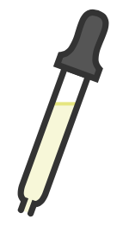
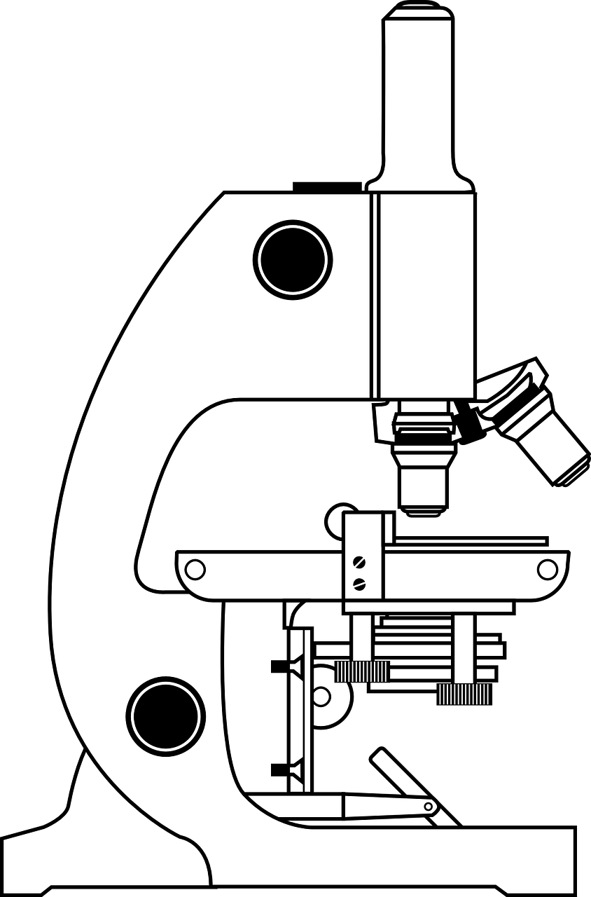

RP1
Light Microscope Required Practical
Preparing a Slide:
Add a drop of water to the microscope slide.
Place a thin layer of tissue on the slide.
Stain the tissue with a couple of drops of iodine solution.
Place the coverslip on top.
Observing a Slide:
Place the slide on the stage and use the lowest power objective lens.
Turn the course focus wheel to bring the image into focus.
Increase the power of the objective lens to increase magnification.
Turn the fine focus wheel to bring the image into clearer focus.
Eyepiece
Course Focus
Objective Piece
Practical Video
Stage
Fine Focus
Clips

Slide 22
Required Practical: Using a Light Microscope
Fold page here
What could you use to stain the sample cells?
Why do you stain the sample cells?
Which lens do you use first when viewing a cell under a microscope?
How do you increase the magnification of the image?
How do you bring the image into a clearer focus?
What is the formula to calculate the real size of a cell?
What are the advantages of using an electron microscope rather than a light microscope?
Suggest why ribosomes cant be seen through a light microscope.
When measuring the length of a cell from an image what unit should you use?
How many µm are in a mm?
How do you convert from mm into µm?
You have increased the magnification and the image you can see is fuzzy. What should you do?
Iodine
So that you can see them.
Lowest power lens.
Increase the power of the objective lens.
Turn the fine focus wheel to adjust the height of the stage.
Magnification = length of drawing/actual length of cell.
Higher resolution and magnification.
They are too small.
mm
1000
Multiply by 1000
Turn the fine focus wheel to bring the image into focus.

Slide 23
Topic | Required Practical 1: Microscopes
Qu | Calculate the real length of the cell.
Info | This is a common calculation question on a Biology exam paper and is often worth 3 marks. It may require you to use a ruler and measure the size of the image. Be careful with this and measure as accurately as you can in mm.
Top Tip | Watch out for units. You may be working in mm and be asked to convert into µm. There are 1000µm in a mm.
Model Answer | The image of a cell is 30mm in length and the magnification is x200. Calculate the actual size of the cell in µm.
 | 30 x 1000 = 30,000µm Magnification = Image length/actual length Actual Length = Image Length/Magnification Actual Length = 30,000 / 200 Actual Length = 150µm | Convert mm into µm Write in the formula Rearrange the formula Substitute numbers Show answer, round if required, then add units
Practice | Complete the following calculations. Remember to show full working. The image of a cell is 32mm in length and the magnification is x400. Calculate the actual size of the cell in µm. The image of a cell is 12mm in length and the magnification is x1000. Calculate the actual size of the cell in µm. The real length of a cell is 0.06mm while the image length is 24mm. Calculate the magnification. An image has a length of 40mm and has been magnified x500. Calculate the actual size of the image. The average diameter of a real red blood cell is 0.008 millimetres. On the photograph, the diameter of the red blood cell is 100 millimetres. Calculate the magnification of the photograph. The image width of the cell was 40 mm. The real width of the cell was 0.1 mm. Calculate the magnification of the cell. An image has a length of 45mm and has been magnified x400. Calculate the actual size of the image. An image has a length of 12mm and has been magnified x150. Calculate the actual size of the image. An image has a length of 22mm and has been magnified x1000. Calculate the actual size of the image. The image of a cell is 52mm in length and the magnification is x400. Calculate the actual size of the cell in µm.

Slide 24
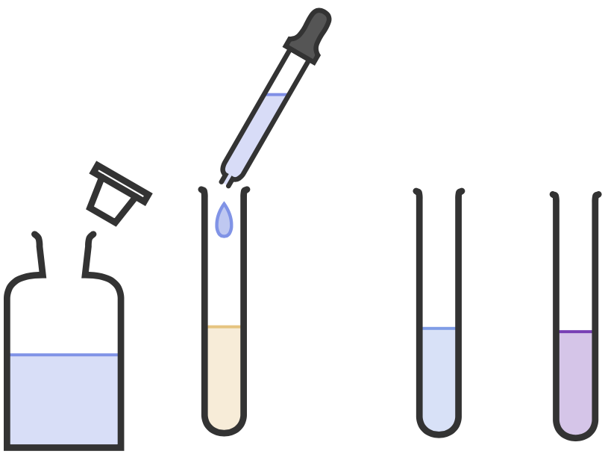

RP3
Food Tests Required Practical
Testing for Proteins
Preparation
If the food is already in solution (such as milk) no further preparation is needed. If the food is solid it needs to be ground up using a pestle and mortar and added to water to make a solution.
Add Biuret Reagent to the food sample.
If there is no protein the
sample remains blue.
Biuret
Reagent
Food
Sample
If there is protein the
sample turns purple.
Practical Video

Slide 25
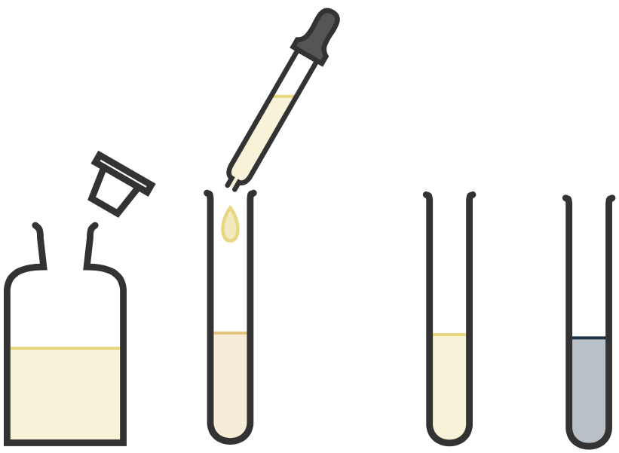
RP3
Food Tests Required Practical
Testing for Starch
Preparation
If the food is already in solution (such as milk) no further preparation is needed. If the food is solid it needs to be ground up using a pestle and mortar and added to water to make a solution.
Add iodine to the food sample.
If there is no starch the
sample remains yellow.
Iodine
Solution
Food
Sample
If there is starch the
sample turns blue/black.
Practical Video

Slide 26
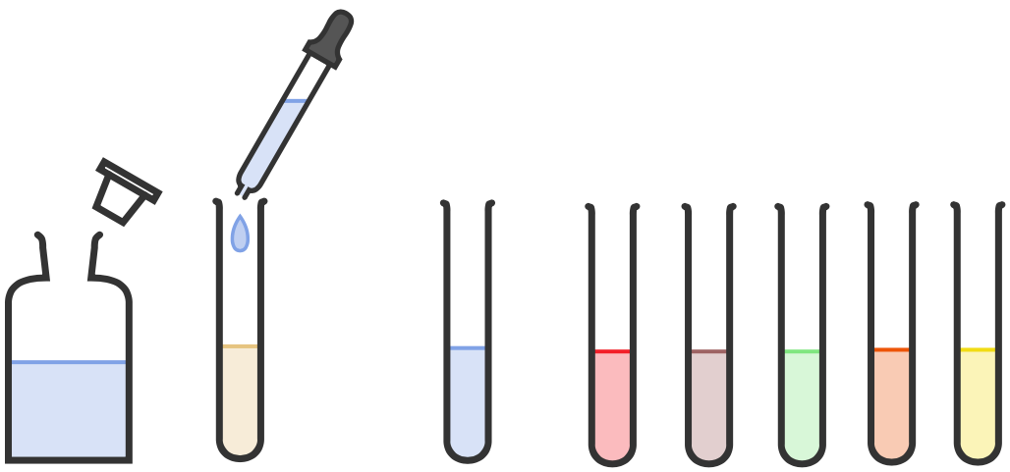
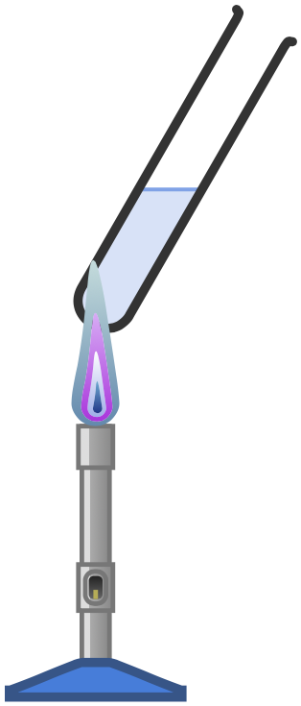
RP3
Food Tests Required Practical
Testing for Glucose
Preparation
If the food is already in solution (such as milk) no further preparation is needed. If the food is solid it needs to be ground up using a pestle and mortar and added to water to make a solution.
If there is no glucose the
sample remains blue.
Add Benedicts Reagent to the food sample.
HEAT
If there is glucose the sample turns red, orange, yellow, brown or green.
Benedicts Reagent
Food
Sample
Practical Video

Slide 27
Required Practical 3: Testing Foods
Fold page here
How do you prepare a solid food sample to test for nutrients?
What reagent is used to test for proteins?
What colour change indicates a positive result for protein?
How do you test for protein?
What reagent is used to test for starch?
What colour change indicates a positive result for starch?
How do you test for starch?
What reagent is used to test for glucose?
What colour change indicates a positive result for glucose?
How do you test for glucose?
What are examples of carbohydrates?
Which reagents would you use to test for carbohydrates?
Grind up using a pestle and mortar and then add water to form a solution.
Biuret solution
Colour change to purple.
Add biuret solution and look for a colour change to purple.
Iodine
Colour changes to blue/black
Add iodine and look for a colour change to blue/black.
Benedicts
A colour change to red/green/orange/yellow
Add Benedicts, heat and look for colour change to red/green/orange/yellow.
Starch and glucose
Amylase for starch and Benedicts for glucose

Slide 28
Topic | Required Practical 3: Testing Foods
Qu | Explain how to test a substance for the presence of _________
Info | You could be asked this question to test for: Starch Glucose Proteins A combination of some/all of them To answer this question you will need to do the following: Identify the chemical you would use to test for the food substance. Describe what you would do. Identify the positive result Repeat steps 1-3 for another food substance if the exam question is asking about more than one substance in the food.
Top Tip | Be careful with your colour changes. Marks will be awarded for identifying the colour that shows a positive result, not for the start colour. If you don’t know the start colour, don’t include it as it could lose you marks.
Model Answer | Explain how to test a substance for the presence of glucose. Add Benedict's solution to your sample of food in solution and heat it. A positive test for glucose would be the solution turning red. If the solution does not change colour no glucose is present.
Practice | Learn and practice the model answer above. Prepare and learn model answers to explain how to test for starch, lipids and proteins. Prepare and learn a model answer to explain how to test 1 food for the presence of glucose, starch and proteins

Slide 29
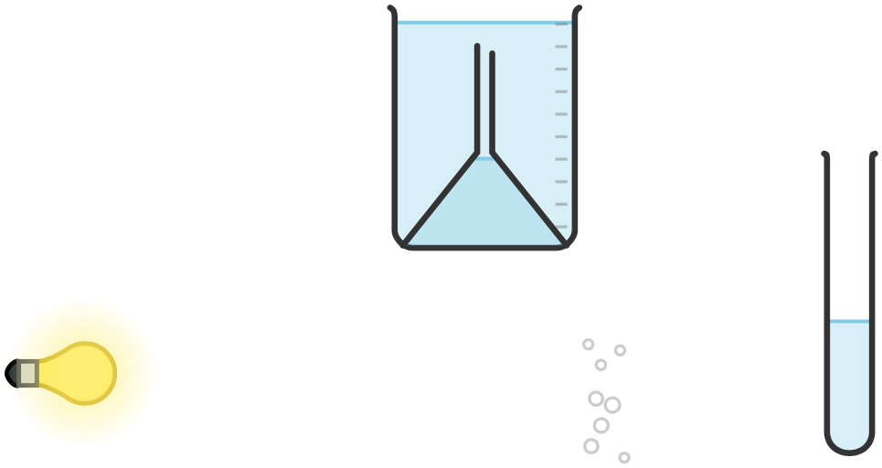



1.
Set up equipment as shown in the diagram with the pondweed in a beaker of water.
2.
Place the beaker 10cm away from the light source.
3.
Turn the light on and leave the pondweed for 5 minutes.
4.
Count the number of bubbles produced in a fixed period of time or measure how much gas is collected in a fixed period of time.
5.
Repeat to identify outliers and calculate averages.
6.
Repeat for different distances/temperatures.
RP5
Investigating Photosynthesis
Bubbles
Lamp
Pondweed
Practical Video
Ruler
Beaker

Slide 30
B5: Photosynthesis Practical
Fold page here
When investigating the rate of photosynthesis what are the possible variables (one that will be changed, the others that will need to be controlled)?
Why do you leave the pondweed 5 minutes after the lamp has been turned on before counting any bubbles?
What piece of equipment would you use to change the distance of the lamp?
What would you use as a light source?
Why should you use an LED bulb when investigating the rate of photosynthesis?
What piece of equipment would you use to measure time?
Why might sodium hydrogen carbonate be added to the water?
Why are bubbles produced by the pondweed during the photosynthesis experiment?
What is the dependent variable when investigating photosynthesis?
Why is it important to use a thermometer when investigating the rate of photosynthesis?
How can we change the light intensity when investigating how light intensity affects the rate of photosynthesis?
How can the temperature be controlled in the experiment?
Why is it better to count the number of bubbles in every minute for 3 minutes rather than just count the bubbles for 3 minutes?
What two measurements need to be taken when investigating the rate of photosynthesis?
An alternative method is to put discs of pondweed/seaweed in a beaker and measure the time to rise to the surface, why would the discs rise to the surface?
Light intensity, temperature, carbon dioxide concentration, type of plant, surface are a of leaf, colour of plant, pH.
Gives the pondweed time to acclimatise.
Ruler
Lamp with an LED bulb.
It does not heat up and raise the temperature of the water.
Stopwatch
To ensure that there is an excess of carbon dioxide and that this does not become a limiting factor.
Number of bubbles produced in a given time.
Oxygen is a product of photosynthesis and so when the pondweed photosynthesises it makes bubbles of the gas that we can count.
It is used to measure the temperature, to check the temperature isn’t changing. This is important as temperature needs to be controlled.
Change the distance the lamp is from the plant.
Add the pondweed sample to a beaker of water, this helps maintain the temperature.
You can see outliers and so improves reliability.
The number of bubbles produced, in a certain time.
They have made oxygen, which causes them to float to the surface.

Slide 31
Topic | Required Practical 5: Light Intensity and Photosynthesis
Qu | Construct a method to investigate the effect of light intensity on the rate of photosynthesis.
Info | You could be asked this question to investigate the effect of light intensity on the rate of photosynthesis for lots of different plants. As you will be collecting gases the plants will all be plants that can survive and photosynthesise under water. To answer this question, you will need to do the following: Construct a clear method. Identify what you will measure. Identify control variables.
Top Tip | To change light intensity, you will change the distance the light is from the test plant. Make sure you include 5 different distances with regular intervals between them.
Model Answer | Construct a method to investigate the effect of light intensity on the rate of photosynthesis. Add a piece of pondweed to a boiling tube filled with water. Place this 10cm away from a light source and turn the light on. Weight 5 minutes for the pondweed to acclimate. Count the number of bubbles produced in 1 minute. Repeat step 4 twice more to identify outliers and calculate an average. Repeat steps 1-5 at 20cm, 30cm, 40cm and 50cm. Control variables include the colour of light and the type and size of pondweed used.
Practice | Learn and practice the model answer above. Prepare and learn model answers to investigate the effect of temperature and light colour on the rate of photosynthesis.

