Slide 1
Chemistry Paper 1
Topics in the Paper:
C3 | Structure and Bonding
C4 | Chemical Calculations
C5 | Chemical Changes
C6 | Electrolysis
C7 | Energy Changes
RP8 | Preparing a Salt
RP9 | Electrolysis
RP10 | Temperature Changes
Chemistry Paper 1
Model Exam Question Booklet
Essential Content for the 2022 Higher Trilogy Science Exam
This booklet is split into 3 parts:
Part 1
The first part is a selection of short response questions and answers that are likely to come in your Chemistry exams this summer. Spend time learning the answers to these questions, for example you could produce flash cards. You should self quiz yourself on these questions regularly!
Part 2
Selection of extended response questions (4 to 6 marks) that are likely to be on your paper this year, either because they have not been assessed in the last couple of years, or because they come up most years in exams. Prepare and practice your responses to these questions.
Part 3
Required practical section. In this section you will find step by step guidance for each practical. This is followed by a page of short response questions and answers to learn for each of the practicals. There are also some extended response questions (4 to 6 marks) that are very likely to be on the exam paper this year.

Slide 2
C3: Structure and Bonding
What are the three types of chemical bonds?
What is an ionic bond?
What is a covalent bond?
What is a metallic bond?
How does an ionic compound form?
What is the charge of an ion from group 1?
What is the charge of an ion from group 2?
What is the charge of an ion from group 6?
What is the charge of an ion from group 7?
What is an ionic compound?
What are simple molecules?
What is the state symbol for a solid?
What is the state symbol for a liquid?
What is the state symbol for a gas?
What is the state symbol for a solution?
What are the properties of ionic compounds?
Why do ionic compounds have high melting and boiling points?
Why can’t ionic compounds conduct electricity when solid?
Why can ionic compounds conduct electricity when molten or dissolved?
What are the properties of simple molecules?
Why do simple molecules have low melting and boiling points?
Ionic, covalent and metallic bonds.
A bond between a metal and non-metal in which electrons have been exchanged.
A bond between two non-metals in which electrons are shared.
A bond between metal atoms in which electrons are delocalised.
The metal loses electrons to get a full outer shell becoming a positively charged ion while the non-metal gains electrons becoming a negatively charged ion. The oppositely charged ions are electrostatically attracted to each other.
+1
+2
-2
-1
A giant structure of ions which are held together by strong electrostatic forces of attraction between oppositely charged ions.
Small molecules such as oxygen and water that contain atoms joined together by covalent bonds.
(s)
(l)
(g)
(aq)
High melting and boiling point. Don’t conduct electricity when solid but do when molten or dissolved.
Strong bonds between molecules which takes lots of energy to overcome.
Ions are unable to move freely.
Ions are free and so are able to move.
Low melting and boiling point. Poor conductors.

Slide 3
C4: Chemical Calculations
What are chemical amounts measured in?
What is the mass in grams of one mole equal to?
What are the units for moles?
What is the Avogadro constant?
What is the value of the Avogadro constant?
How can the balancing numbers in a symbol equation be calculated using reacting masses?
What is a limiting reagent?
In a reaction why should one reactant be added in excess?
What are the units for concentration?
Why is it not always possible to obtain the calculate amount of product?
Moles
Its RFM
Mol
The number of atoms in a mole of a given substance.
6.02x10²³
The masses of reactants and products in grams is converted into moles which is then converted into a simple whole number ratio.
It is the reactant that is completely used up that limits the amount of product made.
To make sure that the other reactant is completely used up.
Mass per given volume.
The reaction may not go to completion because its reversible, some of the product may be lost when it is separated from the reaction mixture or some of the reactants may react in ways different to the expected reaction.

Slide 4
C5: Chemical Changes
How do metal oxides form?
What is reduction?
What is oxidation?
What happens to metals when they react with other substances?
What is the reactivity of a metal determined by?
List metals in order of reactivity.
Which two non-metals are often included in the reactivity series?
How can metals less reactive than carbon be extracted from their oxides?
What is typically made when an acid reacts with some metals?
How can acids be neutralised?
What is the general word equation for a metal reacting with an acid?
What is an example of an alkali?
What is an example of a base?
What is the general word equation for a metal hydroxide reacting with an acid?
What is the general word equation for a metal oxide reacting with an acid?
What is the general word equation for a metal carbonate reacting with an acid?
What type of salt does hydrochloric acid produce?
What type of salt does sulphuric acid produce?
What type of salt does nitric acid produce?
How can a soluble salt be made?
What type of ions do acids produce in solution?
What type of ions do alkalis produce in solution?
What is the pH scale?
What can be used to measure pH?
What is a pH of 7?
What is a pH value less than 7?
What is a pH value more than 7?
What happens during a neutralisation reaction?
Write an equation to represent a neutralisation reaction.
Metals react with oxygen in an oxidation reaction.
Loss of oxygen / gain of electrons.
Gain of oxygen / loss of electrons.
Metal atoms form positive ions.
Their tendency to make positive ions.
Potassium Sodium, Lithium, Calcium, Magnesium, Zinc, Iron, Copper
Hydrogen and carbon.
Reduction with carbon.
Salts and Hydrogen.
Adding it to an alkali.
Metal + Acid → Salt + Hydrogen
Soluble metal hydroxides.
Insoluble metal hydroxides and metal oxides.
Metal Hydroxide + Acid → Salt + Water
Metal Oxide + Acid → Salt + Water
Metal Carbonate + Acid → Salt + Water + Carbon Dioxide
Chloride
Sulphate
Nitrate
Add acid in excess to a solid insoluble substance such as metal, metal oxide, carbonate or hydroxide and filter off the excess. Crystallise the salt solution made.
H⁺
OH⁻
A scale from 0 to 14 that is a measure of acidity or alkalinity of a solution.
Universal indicator or pH probe.
Neutral solution
Acidic solution
Alkali solution
Hydrogen ions react with hydroxide ions to make water.
H⁺ (aq) + OH⁻ (aq) → H₂O(l)

Slide 5
C6: Electrolysis
When can an ionic compound conduct electricity?
What is an electrolyte?
What happens when an electric current is passed through an electrolyte?
What is the cathode?
What is the anode?
Which electrode are positive ions attracted to?
Which electrode are negative ions attracted to?
What happens at the electrode?
What happens when a simple ionic compound is electrolysed?
When is electrolysis used to extract metals?
What are the problems of extracting metals using electrolysis?
How is aluminium extracted using electrolysis?
Why is a mixture used as the electrolyte for the extraction of aluminium?
Why must the positive electrode be replaced during the electrolysis of aluminium?
During the electrolysis of an aqueous solution what does the ion discharged at the electrode depend on?
What is formed on the negative electrode if the metal is more reactive than hydrogen?
When is oxygen made at the positive electrode?
What happens at the cathode? (HT Only)
What happens at the anode? (HT Only)
When it is melted or dissolved.
A liquid or solution that is able to conduct electricity.
The ions move to the electrodes.
Negative electrode.
Positive electrode.
Negative electrode.
Positive electrode.
The ions are discharged at the electrodes producing elements.
The metal forms at the cathode and the non-metal is produced at the anode.
When the metal is too reactive to be extracted by reduction with carbon, or if the metal reacts with carbon.
Large amounts of energy are needed to melt the compound and produce the electrical current.
The aluminium oxide is melted and mixed with cryolite. The aluminium ions move to the negative electrode to make aluminium and the oxygen ions move to the positive electrode to react with the carbon electrode and make carbon dioxide.
The cryolite lowers the melting point of aluminium oxide.
The oxygen reacts with the carbon in the electrode burning it away.
The reactivity of the elements involved.
Hydrogen
When the solution does not contain halide ions.
Positive ions gain electrons and are reduced.
Negative ions lose electrons and are oxidised.

Slide 6
C7: Energy Changes
What happens to energy in a chemical reaction?
What is an exothermic reaction?
What are examples of exothermic reactions?
What are everyday uses of exothermic reactions?
What is an endothermic reaction?
What are examples of endothermic reactions?
What are everyday uses of endothermic reactions?
What is activation energy?
What are reaction profiles?
In terms of particles when do chemical reactions occur?
How could you identify an exothermic reaction using its reaction profile?
How could you identify an endothermic reaction using its reaction profile?
How could you change a reaction profile to show the use of a catalyst.
What happens to bonds during a chemical reaction? (HT Only)
How can the overall energy change be calculated? (HT Only)
It is conserved. The amount of energy at the end of the reaction is the same as the amount of energy at the start.
A reaction in which energy is transferred to the surroundings so the temperature of the surroundings increases.
Combustion, oxidation reactions and neutralisation.
Self heating cans and neutralisation.
A reaction in which energy is transferred from the surroundings to that the temperature of the surroundings decreases.
Thermal decomposition and reaction of citric acid and sodium hydrogencarbonate.
Sports injury packs.
The minimum amount of energy that particles must have to react when the reacting particles collide with each other.
A diagram that can be used to show the relative energies of reactants and products. It shows the activation energy and the overall energy change of a reaction.
When reacting particles collide with enough energy.
The energy in the products is lower than the energy in the reactants.
The energy in the products is higher than the energy in the reactants.
Draw a ”humped line” connecting the reactant and product line that is lower than the activation energy line.
Energy is supplied to break bonds in the reactants and energy is released when bonds in the products are formed.
Calculate the difference between the sum of the energy needed to break the bonds in the reactants and the sum of the energy released when bonds in the products are formed.

Slide 7
C3 Structure and Bonding
Explain the properties of _______________
You could be asked to explain the properties of different materials. Examples of materials include:
Any named salt
Any named metal
Any simple molecule
To answer this question, you will need to do the following:
Identify the type of bond involved.
Describe the structure of the material.
Identify a property of the material
Explain why it has this property linking back to its structure.
Repeat steps 3 and 4 until you have no more properties.
Went explaining why a material does or does not conduct electricity by careful. When talking about materials with covalent or metallic bonds you need to use the key term “electron”, when you are discussing a material with ionic bonds you need to use the key term “ion”.
Explain the properties of calcium fluoride.
Calcium fluoride is an ionic compound. There are strong electrostatic bonds between the ions which are arranged in a regular lattice. Calcium fluoride has a high melting and boiling point this is because the bonds are strong. When solid calcium fluoride is unable to conduct electricity as the ions are unable to move freely. When dissolved or molten calcium fluoride can conduct because the ions are now able to move freely.
Learn and practice the model answer above.
Explain the properties of chlorine, sodium chloride, copper, magnesium and magnesium carbonate.

Slide 8
C4 Chemical Calculations
Calculate the number of moles of ________ in _______
You could be given a mass of any compound or element and be asked to calculate the number of moles that it contains.
To answer this question, you will need to do the following:
Identify the formula of the substance. This may well be in the question.
Calculate the RFM of the substance.
Check that the mass you have been given is in grams. If not convert the units.
Divide the mass in grams by the RFM
Round your answer to the correct number of significant figures.
Read the question carefully. Make sure you have checked how many significant figures you have been asked to give your answer to! If you haven’t been given atomic masses remember to use your periodic table.
Calculate the number of moles of calcium carbonate in 64mg. Give your answer to 3 sf
1. Formula of magnesium carbonate: MgCO₃
2. RFM: = 24 + 12 + (16 x 3) = 84
3. Mass in grams 64/1000 = 0.064g
4. Divide mass by RFM: 0.064/84 = 0.0007619047619
5. Round to correct sig fig 0.000762
Learn and practice the model answer above.
Calculate the number of moles in 150mg of: Carbon Dioxide, Water, Sodium Chloride, Magnesium Oxide, Lithium Fluoride, Copper Sulfate and Copper Carbonate.

Slide 9
C4 Chemical Calculations
Calculate the concentration of a solution.
You could be given a volume of a solution and the mass of a substance that it contains and be asked to use this to calculate a concentration.
To answer this question, you will need to do the following:
Check the volume you have been given in the question is in the same units as the units you have been asked to give in your answer. If not convert!
Check the mass you have been given is in the same units as the units you have been asked to give in your answer. If not convert!
Divide the known mass by the volume you have been given.
Check your answer is to the correct number of significant figures.
Add units
To convert from cm³ into dm³ divide by 1000.
Calculate concentration of hydrochloric acid when it contains 3.2g of hydrogen chloride in 50cm³ of solution. Give your answer to 2 s.f in g/dm³
1. Check volume units: 50/1000 = 0.05dm³
2. Check mass units: 3.2g
3. Divide mass by volume: 3.2/0.05 = 64
4. Round to correct sig fig 64
5. Add units 64g/dm³
Learn and practice the model answer above.
Calculate the concentrations of hydrochloric acid in g/dm³ when: 6.8g is dissolved in 100cm³, when 12.2g is dissolved in 250cm³, when 0.1kg is dissolved in 750cm³ and when 0.25kg is dissolved in 1.5dm³.

Slide 10
C5 Chemical Changes
Explain what you would observe when a metal is added to an acid.
Explain what happens when any acid reacts with any alkali.
Describe how you could determine the pH of a substance.
Explain what you would observe when a metal is added to an acid.
When a metal is added to an acid, I would predict that I would observe bubbles. This is because when a metal is added to an acid hydrogen is produced. I would also expect the container to feel warm, this is because a metal reacting with an acid is an exothermic reaction. Finally, I would expect the metal to disappear over time. This is because it is reacting and making the salt which would dissolve.
Explain what happens when any acid reacts with any alkali.
When an acid and alkali react the H⁺ ions from the acid react with the alkalis OH⁻ ions to make water.
Describe how you could determine the pH of a solution.
To determine the pH of a solution you could add universal indicator. You would observe the colour that the indicator turned and use a chart to identify the pH. You could alternatively use a pH probe by dipping this into the solution and recording the value on the digital display.

Slide 11
C6 Electrolysis
Identify what forms at the __________ electrode and explain how this happens.
You will usually be given a diagram of the electrolysis and the name of the solution that is undergoing electrolysis. You will then be asked what forms at one or both electrodes and be asked to explain how this happens.
To answer this question:
Identify what forms at the electrode. You can use the tips below to help you with this.
Identify the charge of the ion.
Identify that they are attracted to the oppositely charged electrode.
Identify if the ion loses or gains electrons.
Identify if they are reduced or oxidised
Identify (again) what is formed
Anode: At the positive electrode negative ions lose their electrons and are oxidised. If the solution doesn’t contain halides oxygen is made. This oxygen then reacts with the carbon in the electrode to make carbon dioxide.
Cathode: At the negative electrode positive ions gain electrons and are reduced. If the metal is more reactive than hydrogen, then hydrogen forms at the electrode instead.
Explain what forms at the cathode during the electrolysis of copper sulfate.
Copper forms at the negative electrode.
Copper ions have a positive charge...
...and so are are attracted to the oppositely charged negative electrode.
The copper ions gain electrons...
...and are reduced...
To form copper
Explain what forms at the anode during the electrolysis of copper sulfate.
Oxygen forms at the negative electrode.
Oxygen ions have a negative charge...
...and so are are attracted to the oppositely charged positive electrode.
The oxygen ions lose electrons...
...and are oxidised...
To form oxygen. The oxygen then goes on to react with carbon in the electrode to make carbon dioxide gas.
Explain what forms at the electrodes during electrolysis of iron sulfate
Explain what forms at the electrodes during electrolysis of copper chloride
Explain what forms at the electrodes during electrolysis of sodium chloride

Slide 12
C6 Electrolysis
Explain why the electrodes are replaced when O₂ is formed at electrolysis.
Explain when hydrogen gas forms at the negative electrode.
Explain how halogen gases can be formed at the positive electrode.
Explain why the electrodes are replaced when O₂ is formed at electrolysis.
During electrolysis the negative oxygen ions will be attracted to the positive electrode that is made of carbon. The oxygen will then react with the carbon electrode forming carbon dioxide due to the high temperatures. This means that over time the electrode will wear away.
Explain when hydrogen gas forms at the negative electrode.
During electrolysis water breaks down to form hydrogen H⁺ ions. If the metal ions produced during electrolysis are less reactive than hydrogen, then it is the hydrogen ions that are discharged at the negative electrode. Here they gain electrons to form hydrogen molecules.
Explain how halogen gases can be formed at the positive electrode.
Halide ions are negatively charged and so will be attracted to the positive electrode. Here the halide will lose electrons and form molecules. For example, chloride ions will form chlorine gas.

Slide 13
C7 Energy Changes
When an acid is added to an alkali the energy changes. Explain this change.
Define exothermic reaction.
Define activation energy.
When an acid is added to an alkali the energy changes. Explain this change.
An acid reacting with an alkali is an exothermic reaction. This means that heat is released to the environment and so the energy within the products will be less than the energy in the reactants.
Define exothermic reaction.
A reaction in which heat is released to the surroundings.
Define activation energy.
The minimum amount of energy that particles must have to react when the reacting particles collide with each other.

Slide 14
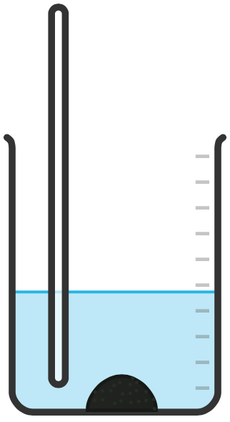
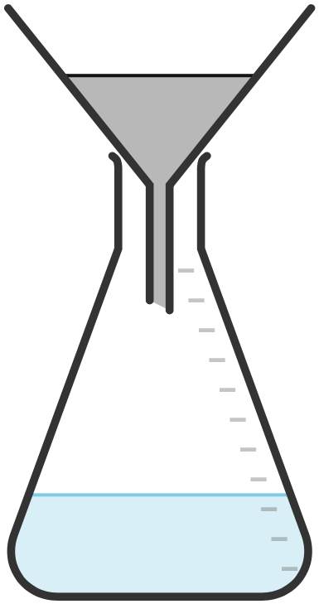

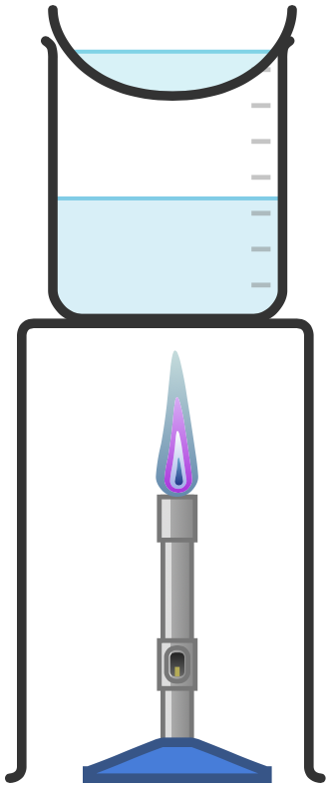

RP8
Making Salts
1
Add the insoluble base in excess to warmed acid.
2
Stir the solution until no more base will react.
3
Filter the contents to remove the excess base.
6
Leave the remaining solution to crystallise over time.
4
Pour the filtered solution into an evaporating basin and evaporate the water using a water bath.
5
Stop heating when crystals start to appear.
Practical Video

Slide 15

RP8: Making Salts Practical
Fold page here
What is neutralisation?
What is filtration?
What is evaporation?
What is crystallisation?
Why is the insoluble base added in excess?
Why is the insoluble base added to warm acid?
Why is the mixture stirred?
What type of acid would you need to use if you wanted to make a sulfate?
What type of acid would you need to use if you wanted to make a chloride?
What type of acid would you need to use if you wanted to make a nitrate?
How is the remaining insoluble base removed from the solution?
What is made during neutralisation?
How is the water removed from the salt solution?
What substances can react with an acid to make a soluble salt?
How can we make sure that all the substances have reacted when making salts?
What safety precautions should you use when making salts?
A chemical reaction between an acid and a base in which a salt and water are formed.
A separation technique used to remove an insoluble substance from a solution.
A separation technique used to remove water from a solution.
A technique that follows evaporation in which crystals form.
To make sure that all of the acid has reacted and is neutralised.
To increase the rate or reaction.
To increase the rate of reaction.
Sulfuric Acid
Hydrochloric Acid
Nitric Acid
Filtration
Salt and water.
Evaporation
Metal, metal hydroxide, metal oxide, metal carbonate, alkali.
Warm the solution and stir.
Wear safety goggles.

Slide 16
Practical | RP8 Making Salts
Qu | Explain how you could make a pure dry sample of ___________.
Info | You could be asked this question for lots of different salts. Some that have come up in the past include: Magnesium Sulfate Calcium Chloride Potassium Chloride Sodium Sulfate To answer this question you will need to do the following: Identify the base and acid that you would add together. Describe how you would ensure all the base had reacted. Describe how you would remove the unreacted base. Describe how you will make sure all the water is removed from the salt.
Top Tip | Sometimes you can be asked to write a method, while sometimes they give you a method and ask you to improve it – watch out here that they are adding the correct chemicals together.
Model Answer | Explain how you could make a pure dry sample of magnesium sulfate. I would add magnesium oxide in excess to warmed sulfuric acid. This would be stirred until no more magnesium oxide will react. To remove the excess magnesium oxide the solution should be filtered using a funnel and filter paper. The solution will then be warmed in an evaporating dish using a water bath to evaporate the water. As soon a crystals start to form the solution will be removed from the heat so that crystallisation can occur.
Practice | Learn and practice the model answer above. Prepare and learn model answers to explain how you would make pure dry samples of calcium chloride, potassium chloride and sodium sulfate.

Slide 17
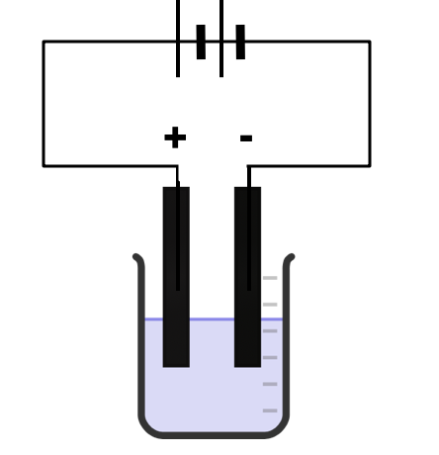

RP9
Electrolysis
Set up equipment as shown in the diagram:
Add the test solution to the beaker.
Dip the electrodes attached to a power supply into the beaker to complete the circuit.
Observe and record what happens at the electrodes.
Practical Video

Slide 18
RP9: Electrolysis Practical
Fold page here
What is electrolysis?
What is an electrolyte?
For the electrolysis of an aqueous solution why is it able to conduct electricity?
What is the positive electrode known as?
What is the negative electrode known as?
What are the electrodes made from?
What happens to the positive ions in the solution?
What happens to the negative ions in the solution?
When is a metal formed at the cathode during electrolysis of an aqueous solution?
When is hydrogen formed at the cathode during electrolysis of an aqueous solution?
Which metals are more reactive than hydrogen?
Which metals are less reactive than hydrogen?
What would be formed at the cathode if any metal except copper, silver or gold were in solution?
What would be formed at the cathode if the solution contained copper?
Why would a solution containing copper appear to fade in colour during electrolysis?
Why would solutions containing any metal apart from copper, silver and gold not appear to fade in colour over time?
What will form at the anode if the negative ion is chloride?
What will form at the anode if the negative ion is a bromide?
What will form at the anode if the negative ion is a iodide?
What will form at the anode if the negative ion is a nitrate?
What will form at the anode if the negative ion is a sulfate?
When does oxygen form at the anode during electrolysis of an aqueous solution?
If you are asked to collect a gas during electrolysis why would you not use a test tube?
If you are asked to collect a gas during electrolysis what equipment should you use to collect it?
If you are investigating a hypothesis for electrolysis what are the possible variables, one you could change, and the others you would need to keep the same?
Breakdown of a substance using electricity.
A liquid containing free moving ions which is broken down by electricity during electrolysis.
The solution contains ions which are free to move.
Anode
Cathode
Graphite
They are attracted to the cathode and are reduced (gain electrons).
They are attracted to the anode and are oxidised (lose electrons).
When the metal is less reactive than hydrogen.
When the metal is more reactive than hydrogen.
Potassium, Sodium, Calcium, Magnesium, Aluminium, Zinc, Iron, Tin, Lead.
Copper, Silver, Gold
Hydrogen
Copper
The copper ions which give the solution its colour have moved to the cathode and formed copper metal. There are fewer copper ions in the solution and so the colour will fade.
The metal ions are more reactive than hydrogen and so are not removed from the solution.
Chlorine
Bromine
Iodine
Oxygen
Oxygen
If the negative ion is not a group 7 halide.
They don’t have a scale so can't be used to measure volume.
Small measuring cylinder.
The chemicals in the solution, volume of pure water used, the concentration of the solution, the volume of the solution, the distance between electrodes, the material of the electrodes, same depth of electrodes in the solution, constant power supply, the amount the solution is stirred,

Slide 19
Practical | Electrolysis Practical
Qu | Describe how you would test the hypothesis _________________
Info | You could be asked this question for some different hypothesis. Some that have come up in the past include: When different salt solutions are electrolysed with inert electrodes, the product at the negative electrode is always a metal. When different salt solutions are electrolysed with inert electrodes, the product at the negative electrode is always hydrogen. To answer this question you will need to do the following: Describe how to set up the equipment (drawing a labelled diagram is even better) Identify what you will be changing Identify what you will record/measure Identify what you will control
Top Tip | Sometimes you may be asked to predict what will be formed at the electrodes. Remember for the positive electrode chlorides make chlorine, bromides make bromine and iodides make iodine. For every other negative ion oxygen will be made. At the negative electrode unless you have copper or silver in the solution you will make hydrogen gas. If you have copper or silver, you will make these metals at the electrode.
Model Answer | Describe how you would test the hypothesis ‘when different salt solutions are electrolysed with inert electrodes, the product at the negative electrode is always a metal.’
Practice | Learn and practice the model answer above. Prepare and learn model answers to explain how you would test the hypothesis that hydrogen is always made at the negative electrode
Set up equipment as shown in the diagram. Add your first test solution to the beaker, dip in the electrodes and turn on the power supply. Record observations at each electrode into results table. Repeat for different test solutions containing different metal ions. If the hypothesis is correct a metal should form on the cathode for each test solution. Control the distance the electrodes are dipped into the solution.

Slide 20
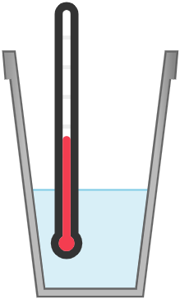

RP10
Temperature Changes
Add the acid into a polystyrene cup.
Record the start temperature of the solution.
Add the other reactant (test solution) to the polystyrene cup.
Add the lid and stir the solution
Record the highest/lowest temperature that you observe.
Calculate the temperature change.
Repeat steps 1-6 2 more times to identify outliers and calculate an average.
Repeat sets 1-7 with 4 different test solutions.
Thermometer
Lid with hole in
Polystyrene Cup
Practical Video

Slide 21
RP10: Temperature Changes
Fold page here
If you are investigating the effect of a particular factor on the temperature change what are the possible variables, one you could change, and the others you would need to keep the same?
When investigating the effect of a particular factor on temperature change what will be your dependent variable?
How do you determine temperature change?
Why should a polystyrene cup be used when investigating temperature change?
Why should the polystyrene cup used have a lid?
How can you use temperature change to determine the reactivity of some metals?
What equipment would you use to measure the volume of your solutions?
If you were adding a solid to the acid, what equipment would you use to measure the mass?
What equipment would you use to measure the start and end temperature?
How would you know if the reaction was endothermic?
What is an endothermic reaction?
What is an exothermic reaction?
How would you know if the reaction was exothermic?
Type of acid, concentration of acid, volume of acid, type of metal, surface area of metal, mass of metal
Temperature change.
Measure the start and end temperature. Take the start temperature away from the end temperature.
Polystyrene is a good insulator and reduces energy transfers with the surroundings.
Reduces energy transfers with the surroundings.
Add the metals to a controlled volume of acid in a polystyrene cup and record the temperature change. The larger the temperature change the more reactive the metal.
Measuring cylinder
Balance
Thermometer
The temperature would decrease.
A reaction that transfers energy from the surroundings.
A reaction that transfers energy to the surroundings.
The temperature would increase.

Slide 22
Practical | RP10: Temperature Change
Qu | Explain how you could investigate the effect of ________ on temperature change.
Info | You could be asked this question for some different variables. Some that have come up in the past include: The reacting acid and metal The reacting acid and metal carbonate Neutralisation reactions Displacement of metals To answer this question you will need to do the following: Describe how to set up the equipment (drawing a labelled diagram is even better) Identify what you will be changing Identify what you will record/measure Identify what you will control
Top Tip | You could be asked to write a method to explain how you would determine the reactivity of some metals. To do this you need to write a method for investigating temperature change. The more reactive the metal, the greater the change in temperature. When you have your results for the different metals you would list them in order of biggest temperature to smallest temperature change. By doing this you are listing the metals in order of reactivity.
Model Answer | Explain how you could investigate the effect of the reacting acid and metal on temperature change.
Practice | Learn and practice the model answer above. Prepare and learn model answers to explain how you could investigate the effects of reacting acid and metal carbonate, neutralisation reactions and displacement reactions on temperature change.
Set up equipment as shown in the diagram. Add 50cm³ acid into a polystyrene cup and record the start temperature of the solution. Add a metal to the cup and then add the lid. Stir the solution through the hole in the lid using the thermometer and record the highest/lowest temperature change observed. Calculate the temperature change and repeat twice more to calculate an average. Repeat the whole practical with 4 different metals. Control the type, volume and concentration of acid.

